Slide 1

BREAST CANCER DIAGNOSIS
Michael Ngala

Slide 2
BACKGROUND
GOAL OF THE STUDY
To create a model to predict the possible diagnosis of breast cancer as may be applied amongst women or men—whether benign (healthy) or malignant (cancerous).
Features are computed from a digitized image of a fine needle aspirate (FNA) of a breast mass. They describe characteristics of the cell nuclei present in the image. Separating plane described above was obtained using Multisurface Method-Tree (MSM-T). Relevant features were selected using an exhaustive search in the space of 1-4 features and 1-3 separating planes.

Slide 3
Summary of the Data Set
Source of dataset: University of California (Irvine)
The Breast Cancer Wisconsin (Diagnostic) dataset used contains 569 samples labeled as benign (B) or malignant (M).
Features/variables: 32—including Id (sample id) and Diagnosis (response) columns
30 predictor features were used to model the diagnosis of individual samples collected.
All 30 predictors were numerical (i.e. no categorical predictor)
Response variable (Diagnosis) was categorical: Benign (B) or Malignant (M).
Categorical—unbalanced distribution(63% to 37%)

Slide 4
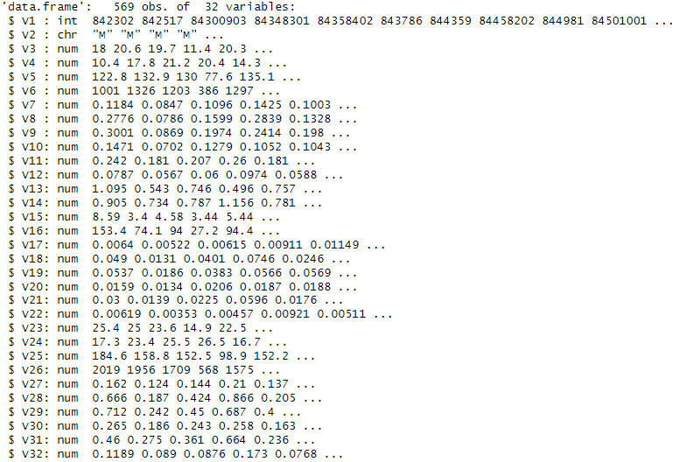
Structure of the data set Dataset structure with all 32 variables/features [V1 and V2 were removed before preprocessing data]

Slide 5
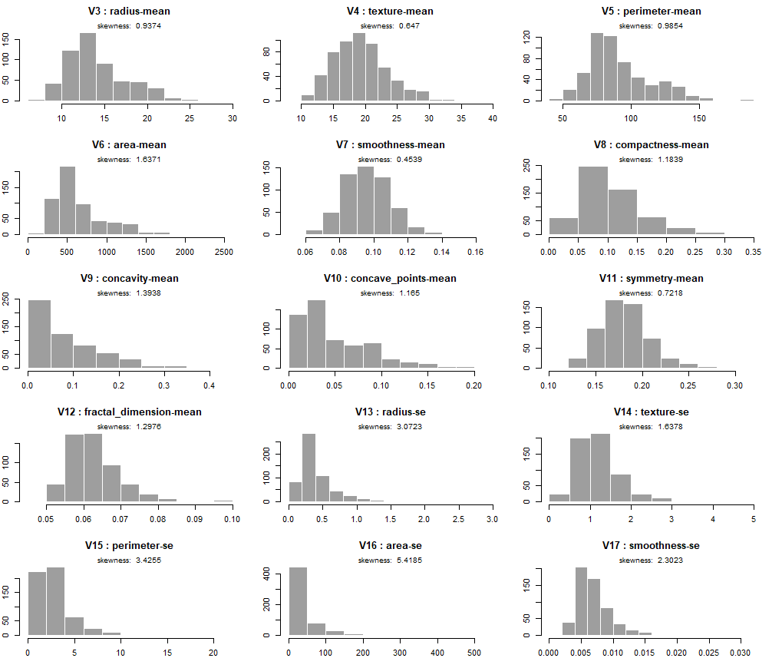
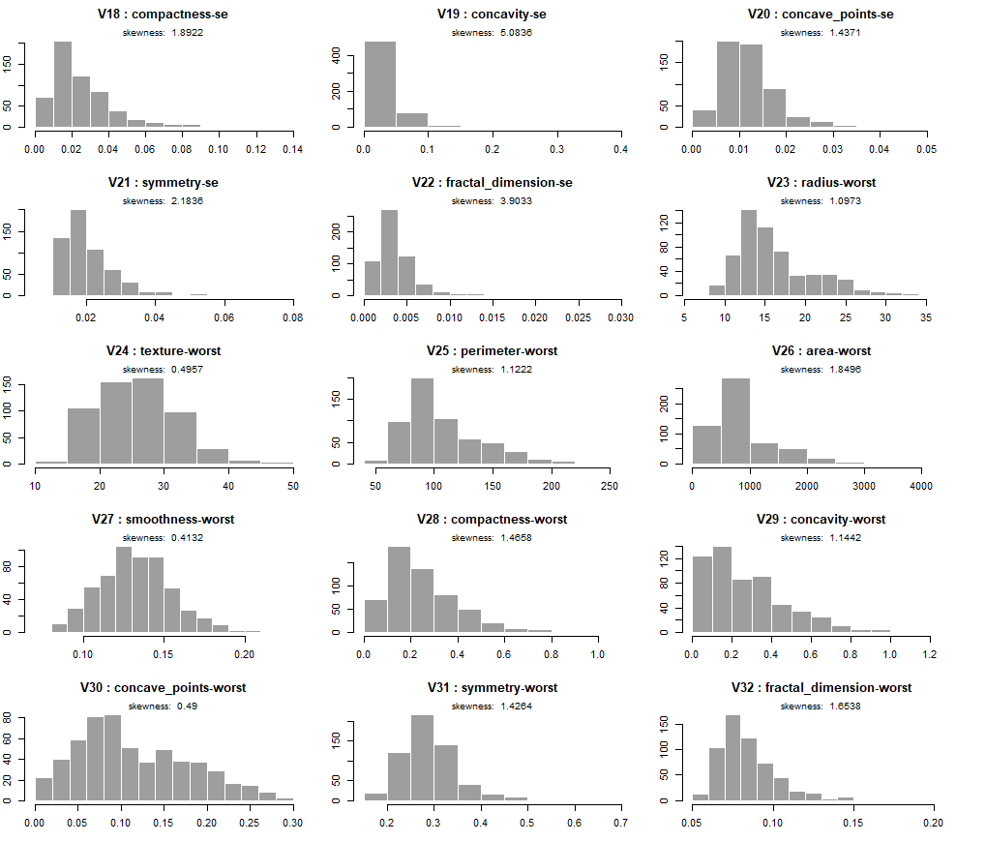
The histogram below was plotted to explore the distribution of the 30 predictor features.

Slide 6
Predictor skewness from the histograms
Predictor | Skewness | Range | Interpretation
V3-radius-mean | 0.9374168 | Between +0.5 and +1 | Moderately right skewed
V4-texture-mean | 0.6470241 | Between +0.5 and +1 | Moderately right skewed
V5-perimeter-mean | 0.9854334 | Between +0.5 and +1 | Moderately right skewed
V6-area-mean | 1.6370654 | Greater than +1 | Heavily right skewed
V7-smoothness-mean | 0.4539207 | Between -0.5 and +0.5 | Approximately symmetric
V8-compactness-mean | 1.1838556 | Greater than +1 | Heavily right skewed
V9-concavity-mean | 1.3938008 | Greater than +1 | Heavily right skewed
V10-concave_points-mean | 1.1650124 | Greater than +1 | Heavily right skewed
V11-symmetry-mean | 0.7217877 | Between +0.5 and +1 | Moderately right skewed
V12-fractal_dimension-mean | 1.2976191 | Greater than +1 | Heavily right skewed
V13-radius-se | 3.072347 | Greater than +1 | Heavily right skewed
V14-texture-se | 1.637773 | Greater than +1 | Heavily right skewed
V15-perimeter-se | 3.425480 | Greater than +1 | Heavily right skewed
V16-area-se | 5.418500 | Greater than +1 | Heavily right skewed
V17-smoothness-se | 2.302262 | Greater than +1 | Heavily right skewed
V18-compactness-se | 1.892203 | Greater than +1 | Heavily right skewed
V19-concavity-se | 5.083550 | Greater than +1 | Heavily right skewed
V20-concave_points-se | 1.437070 | Greater than +1 | Heavily right skewed
V21-symmetry-se | 2.183573 | Greater than +1 | Heavily right skewed
V22-fractal_dimension-se | 3.903304 | Greater than +1 | Heavily right skewed
V23-radius-worst | 1.0973059 | Greater than +1 | Heavily right skewed

Slide 7
V24-texture-worst | 0.4956970 | Between -0.5 and +0.5 | Approximately symmetric
V25-perimeter-worst | 1.1222227 | Greater than +1 | Heavily right skewed
V26-area-worst | 1.8495814 | Greater than +1 | Heavily right skewed
V27-smoothness-worst | 0.4132383 | Between -0.5 and +0.5 | Approximately symmetric
V28-compactness-worst | 1.4657948 | Greater than +1 | Heavily right skewed
V29-concavity-worst | 1.1441794 | Greater than +1 | Heavily right skewed
V30-concave_points-worst | 0.4900213 | Between -0.5 and +0.5 | Approximately symmetric
V31-symmetry-worst | 1.4263764 | Greater than +1 | Heavily right skewed
V32-fractal_dimension-worst | 1.6538237 | Greater than +1 | Heavily right skewed
From the skewness values in the table above, 4 predictors are approximately symmetric, 4 predictors are moderately right skewed, and remaining 22 of the 30 predictors are heavily skewed to the right

Slide 8
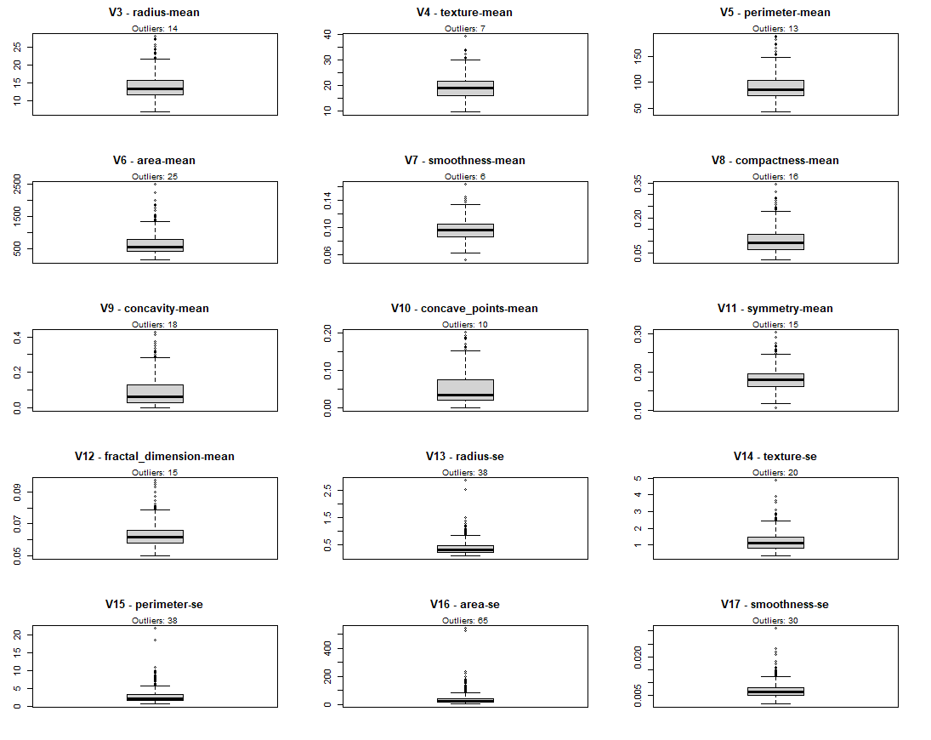
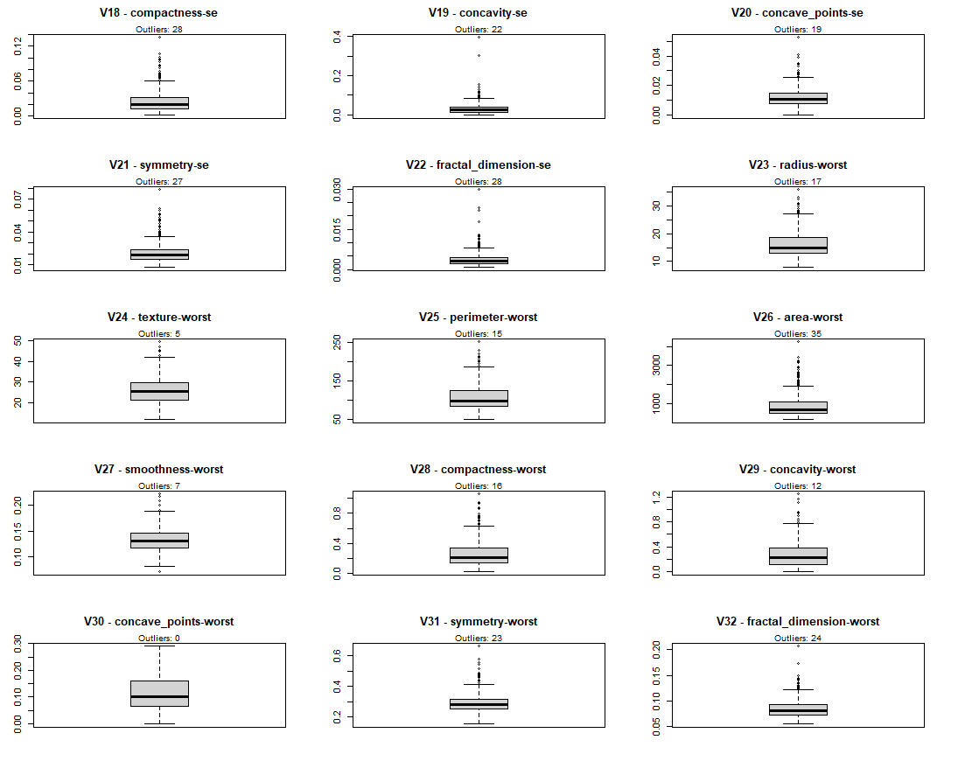
Boxplots of Predictor Features to show outliers

Slide 9
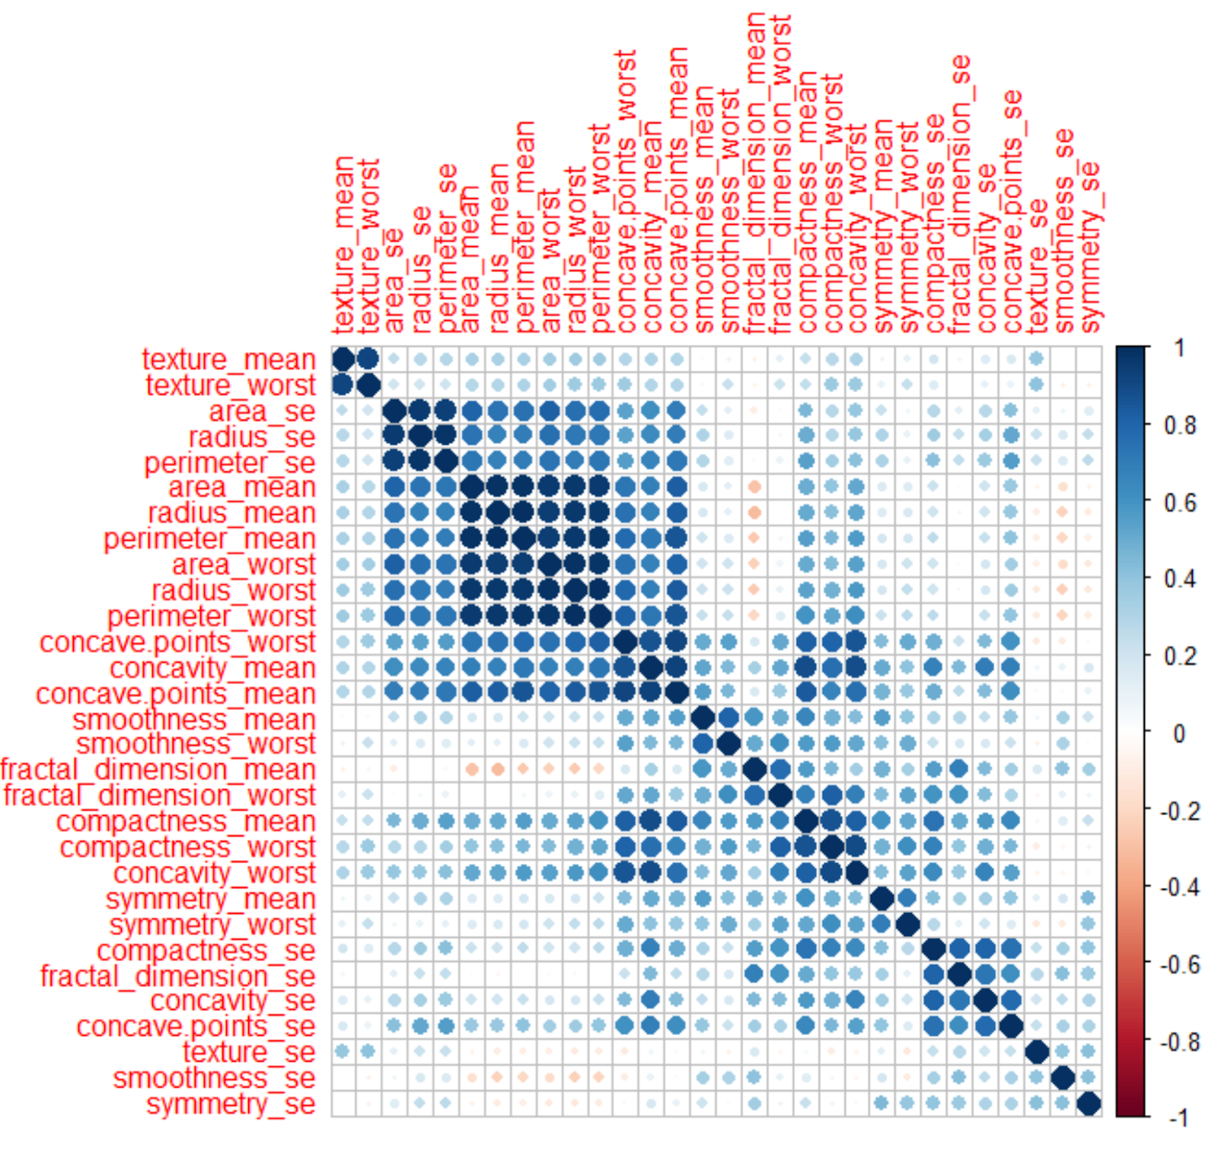
The correlation matrix below gives the relationship between the predictor features.

Slide 10
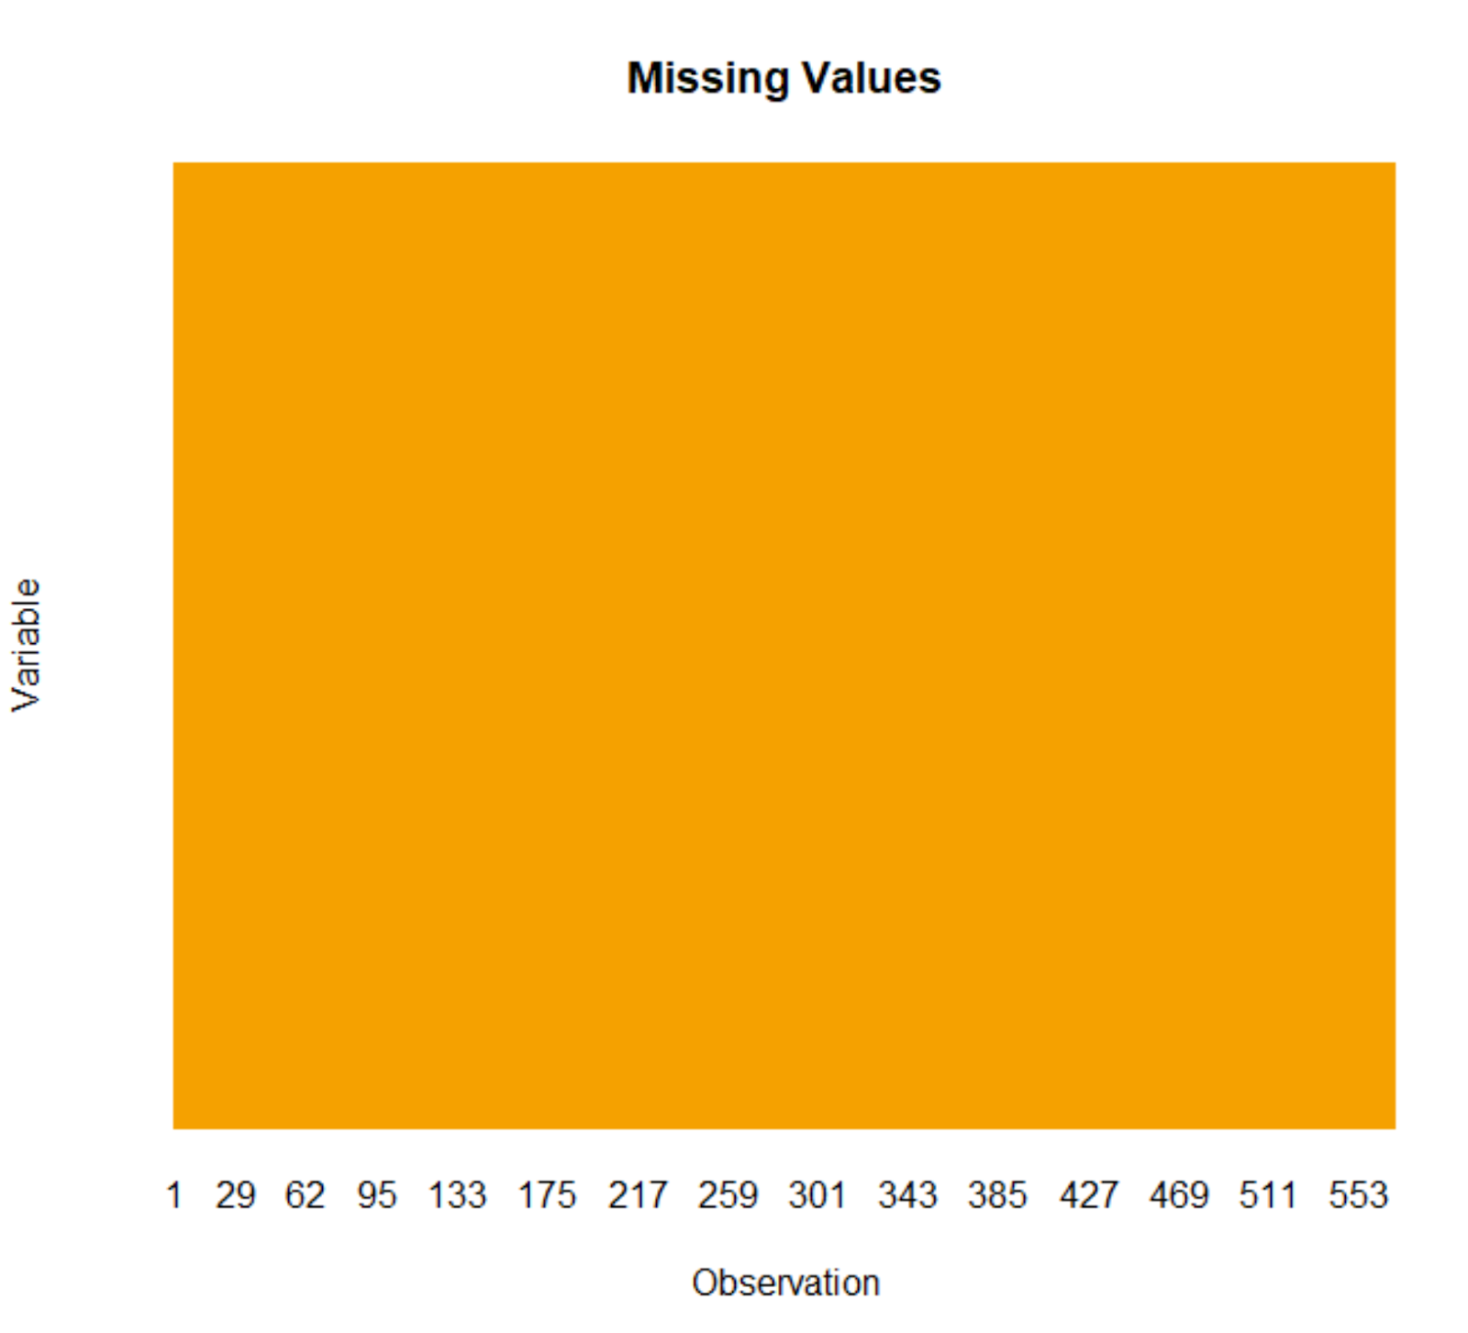
Checking for missing values
There are no missing values

Slide 11
From the data structure analysis of the dataset, there are no categorical predictors; hence no need for dummy variables.
There were no degenerate or near-zero variance columns found amongst the predictors.

Slide 12
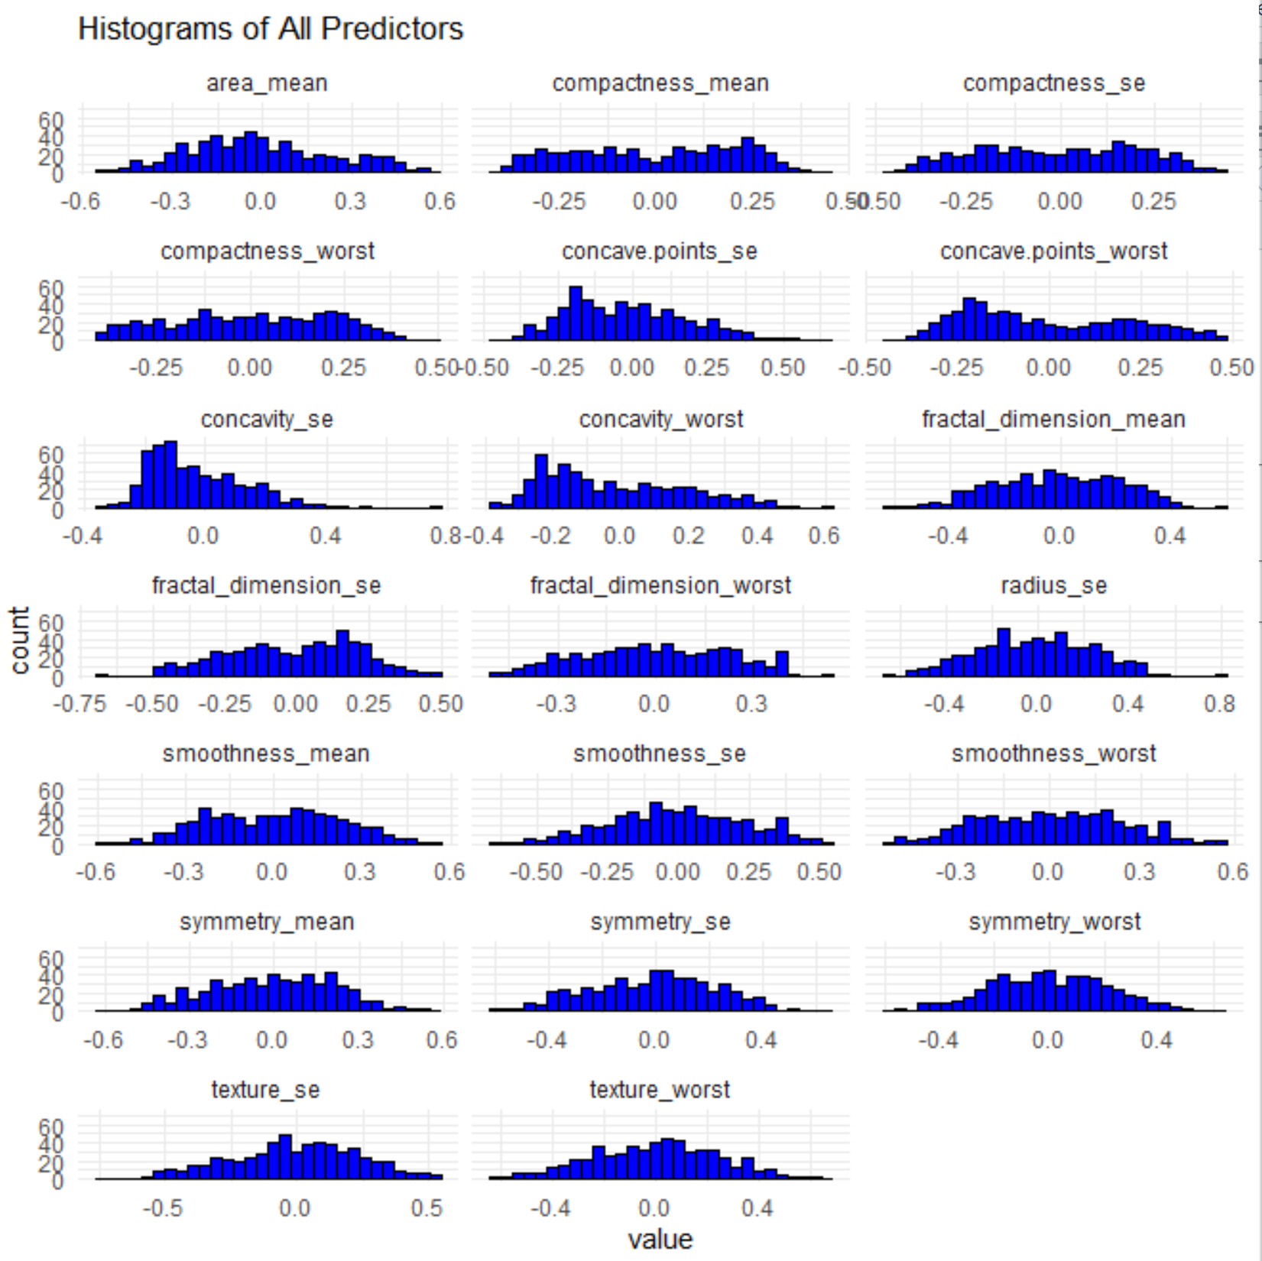
HISTOGRAM OF TRANSFORMED PREDICTORS

Slide 13
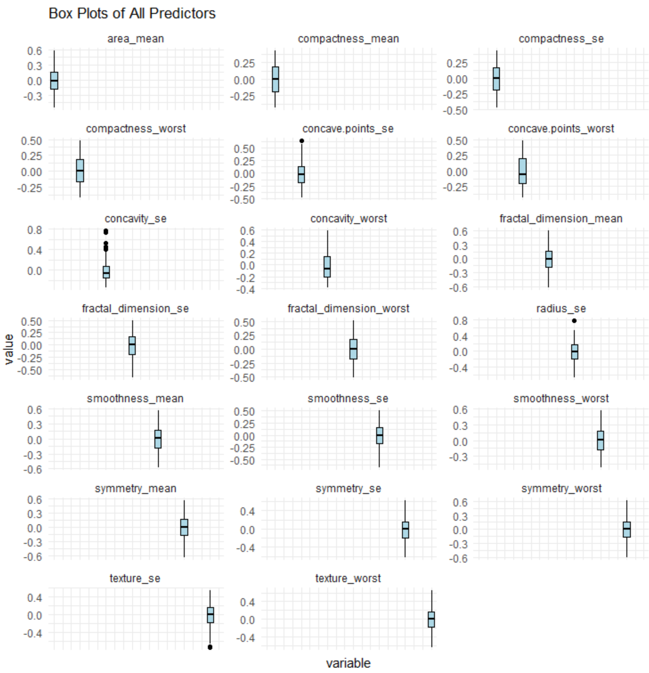
BOX PLOT OF TRANSFORMED PREDICTORS

Slide 14
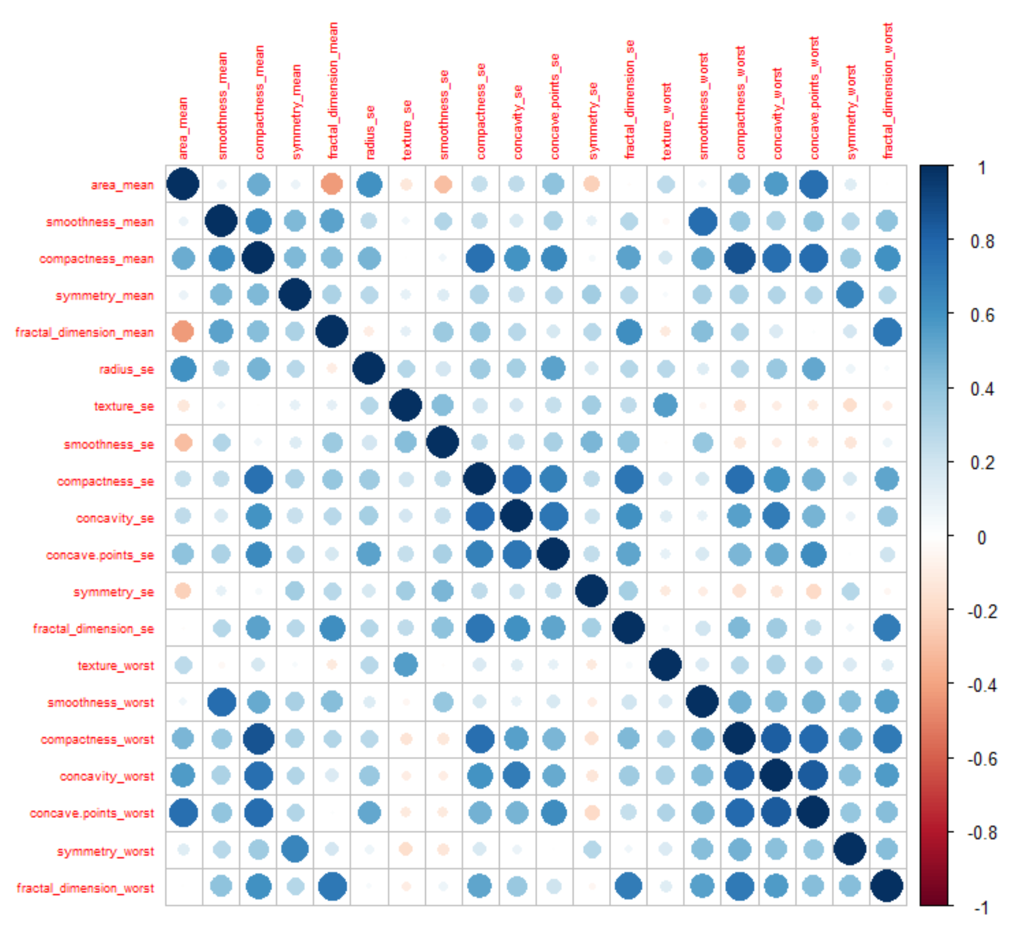
CORRELATION PLOT OF TRANSFORMED PREDICTORS

Slide 15
RESAMPLING
The resampling technique used was stratified random sampling where by the data was split into 80-20 for training and testing.

Slide 16
LINEAR MODELS
LOGISTIC REGRESSION MODEL
LINEAR DISCRIMIANT ANALYSIS
PLSDA
PENALIZED MODEL
NEAREST SHRUNKEN CENTROIDS

Slide 17
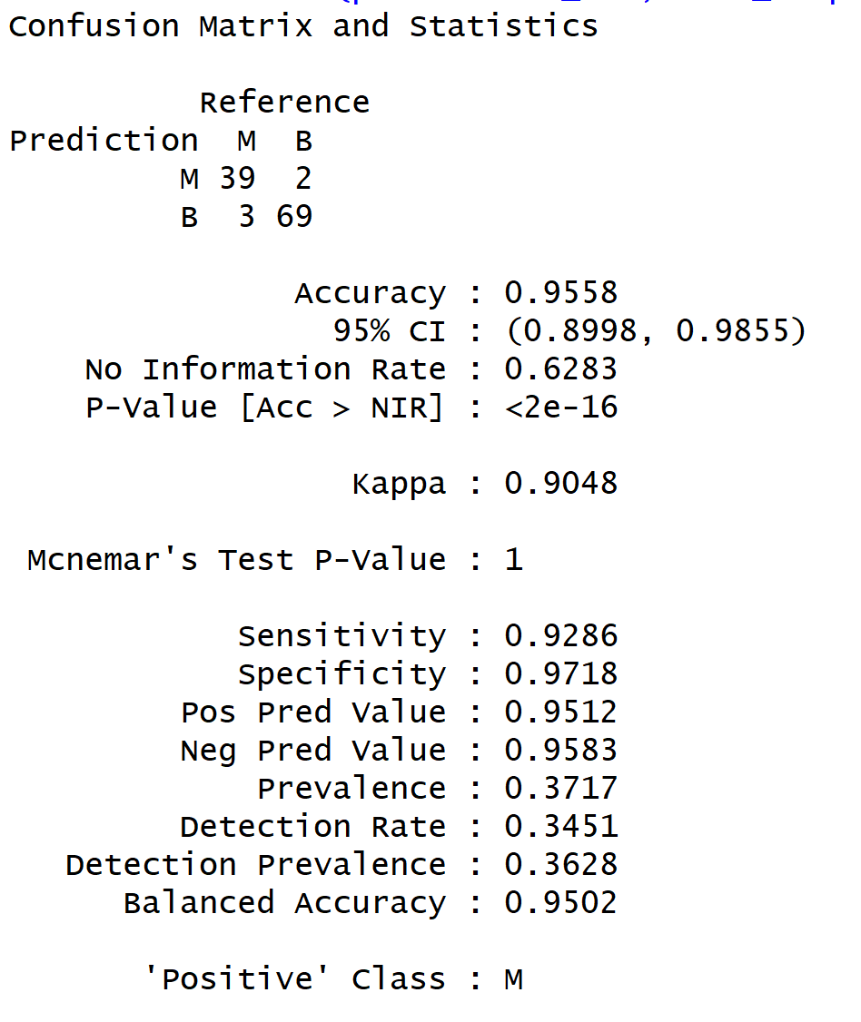
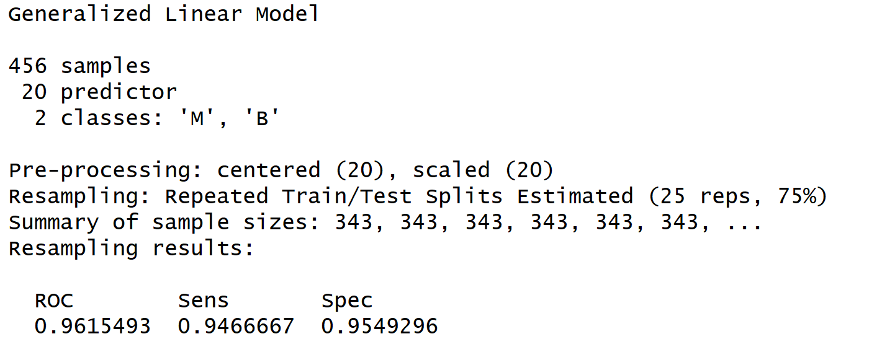
LOGISTIC REGRESSION MODEL
Training Values
Confusion Matrix

Slide 18
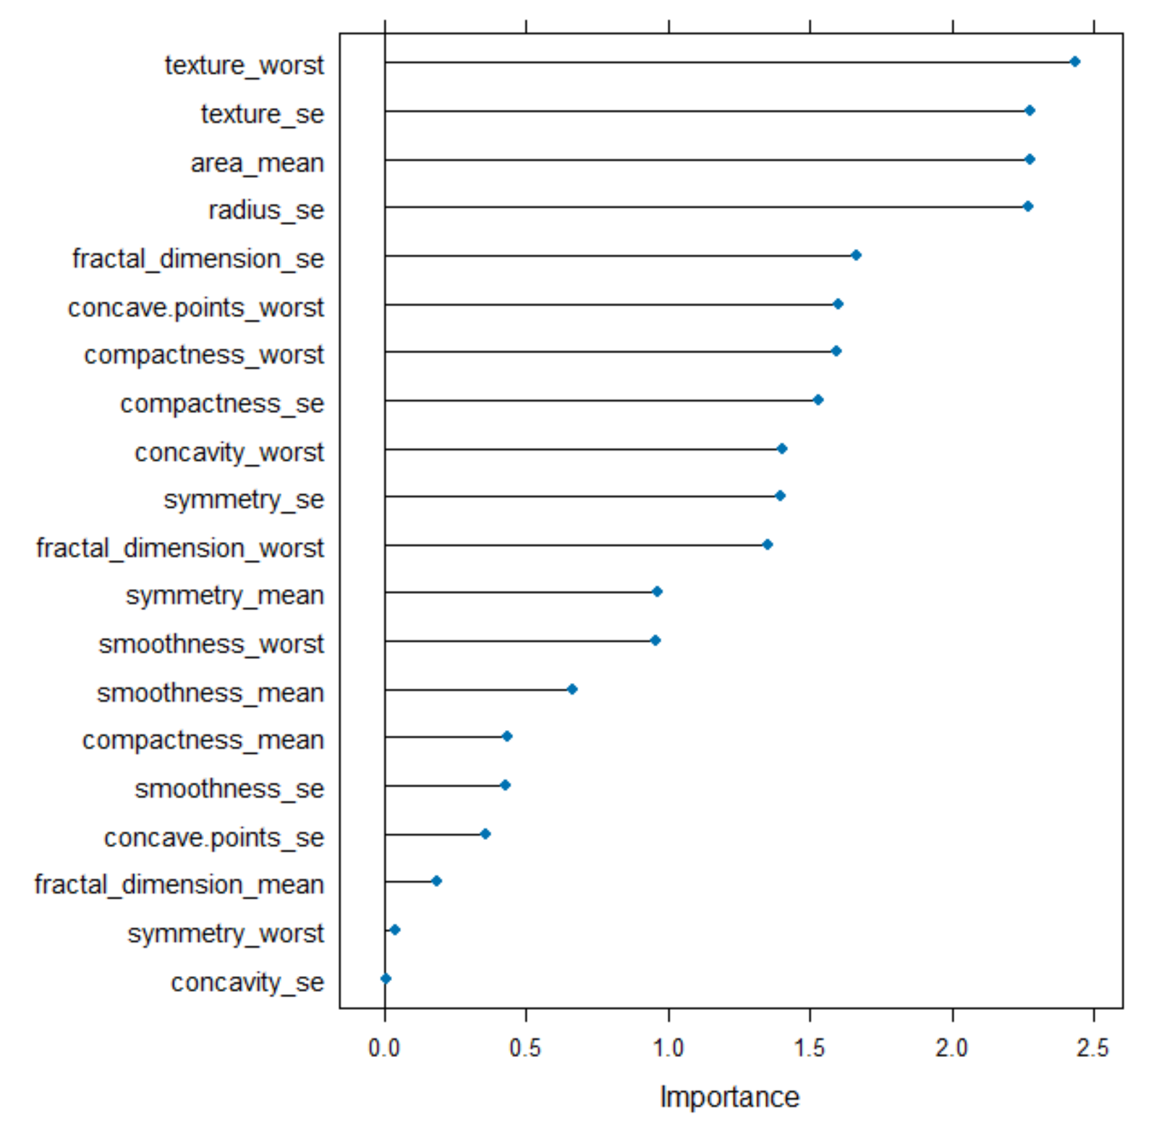
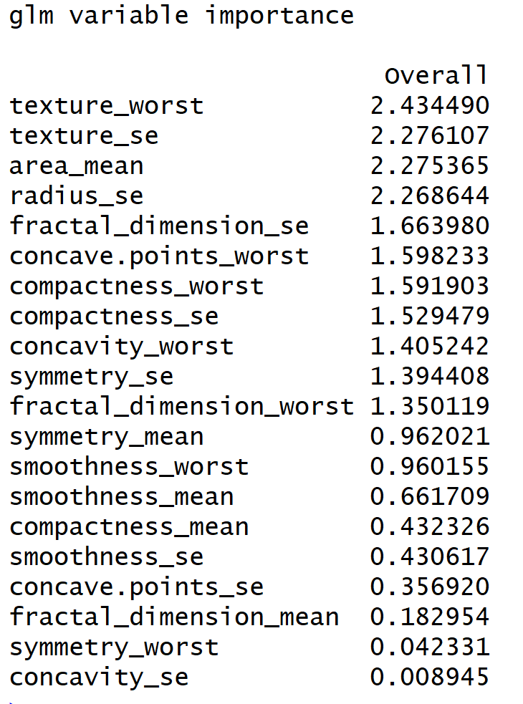
Variable of Importance

Slide 19
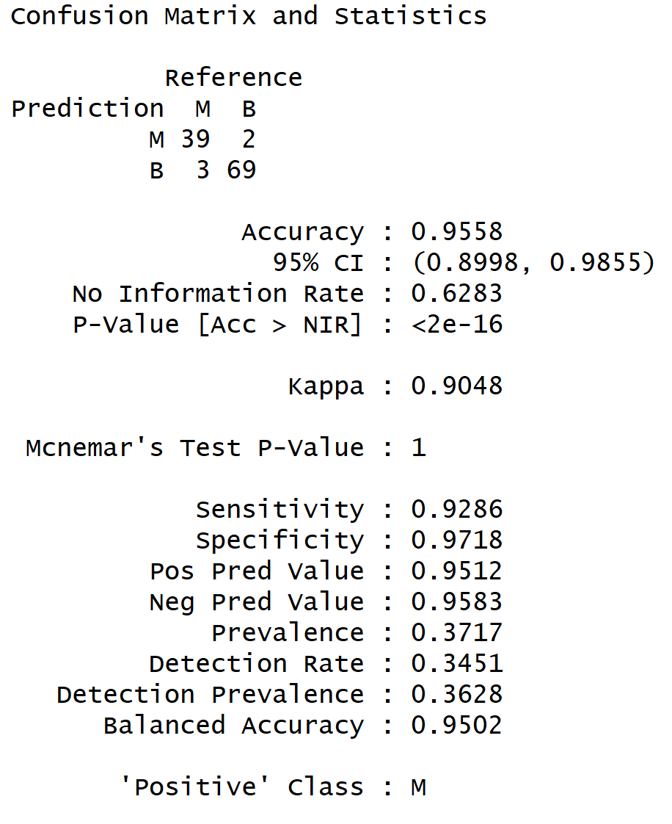
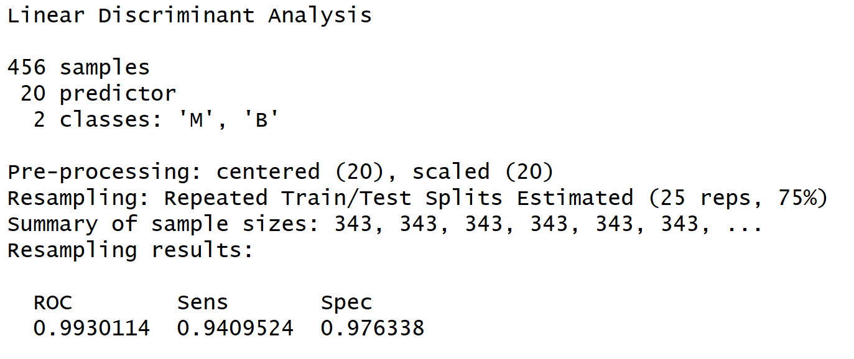
LINEAR DISCRIMINANT ANALYSIS
Confusion Matrix
Training

Slide 20
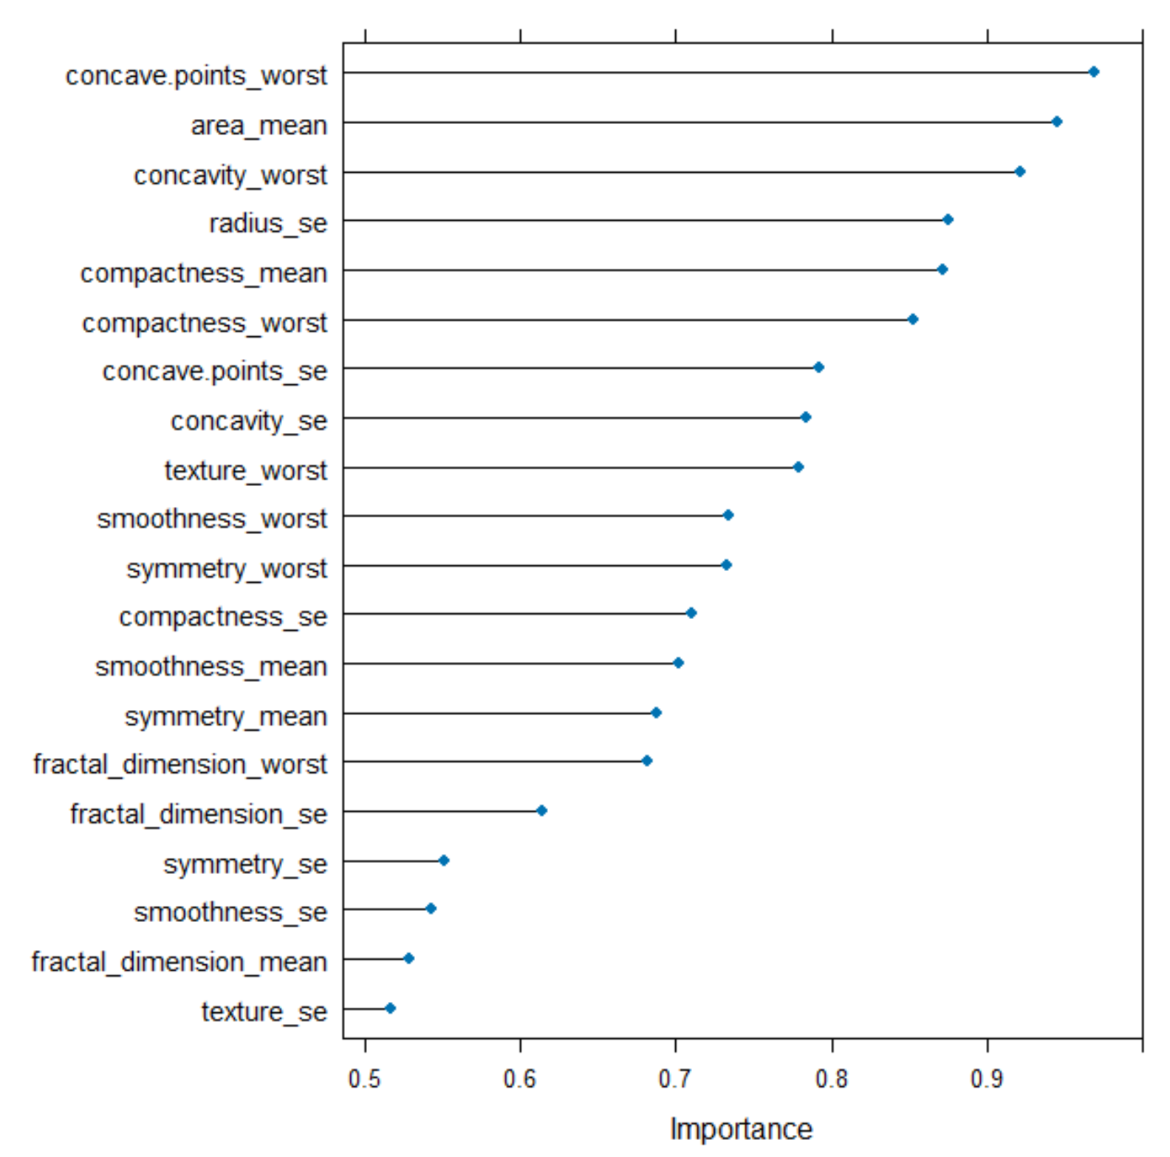
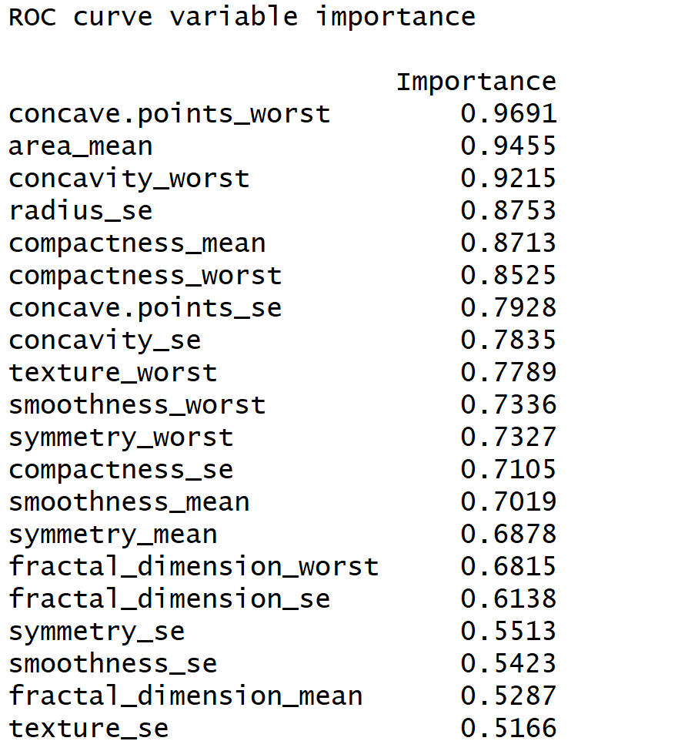
Variable of Importance

Slide 21
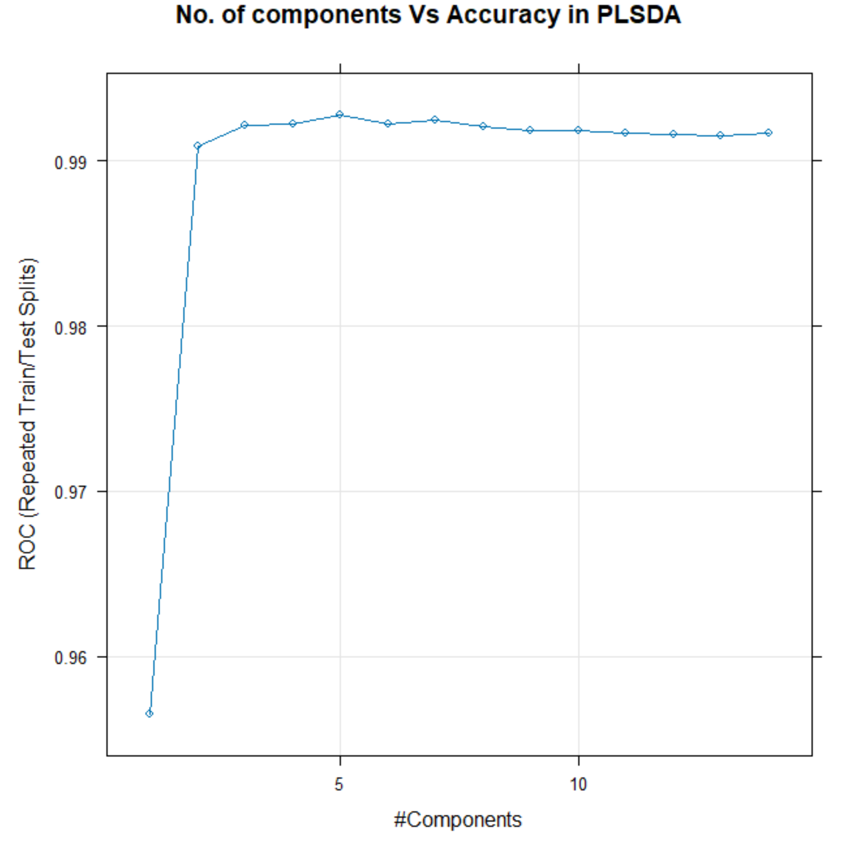
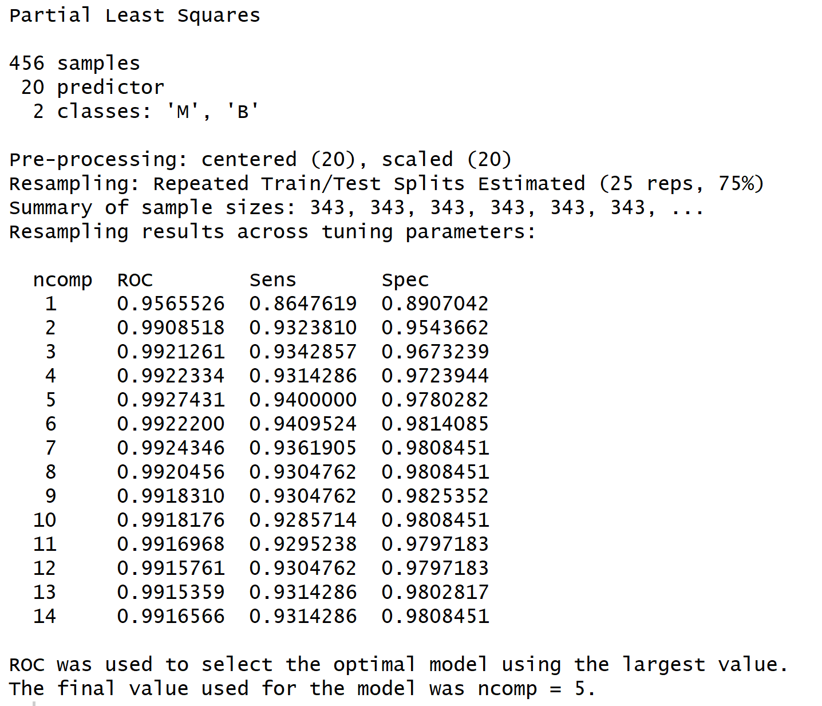
PARTIAL LEAST SQUARE DISCRIMINANT ANALYSIS(PLSDA)
Model plot
Training

Slide 22
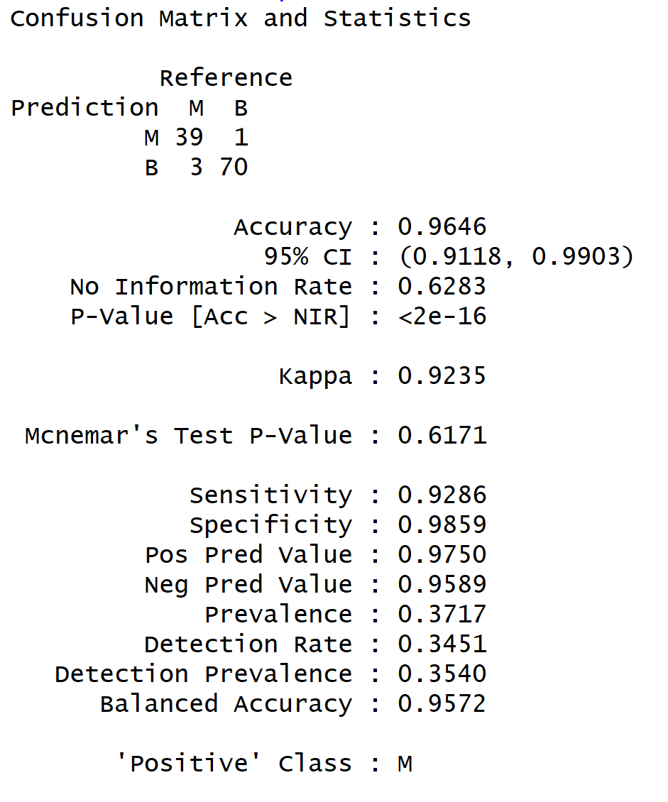
Confusion Matrix

Slide 23
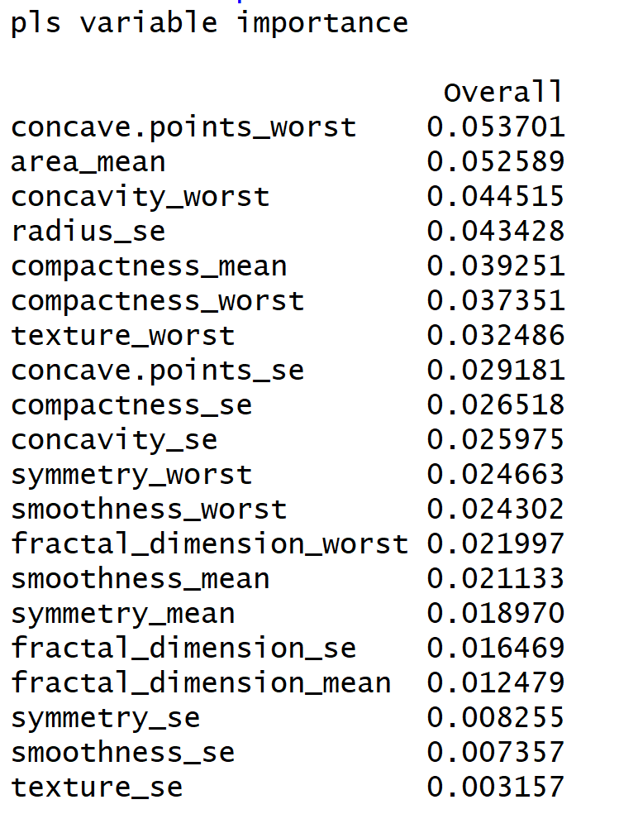
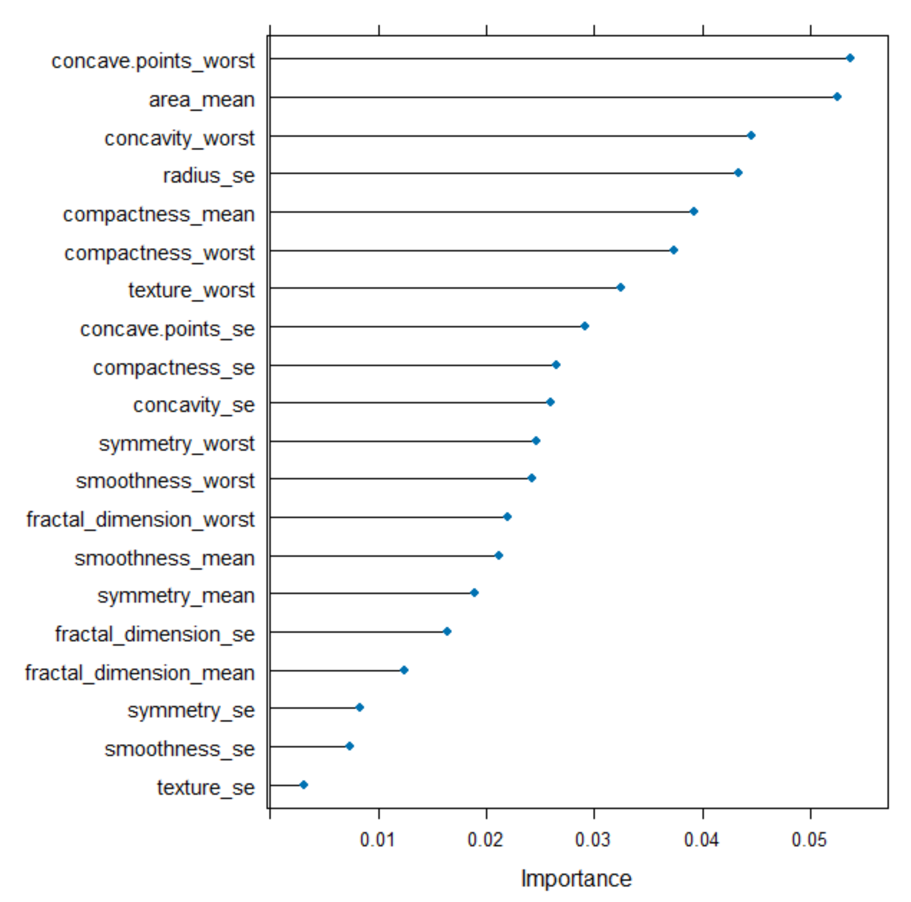
VARIABLE OF IMPORTANCE

Slide 24
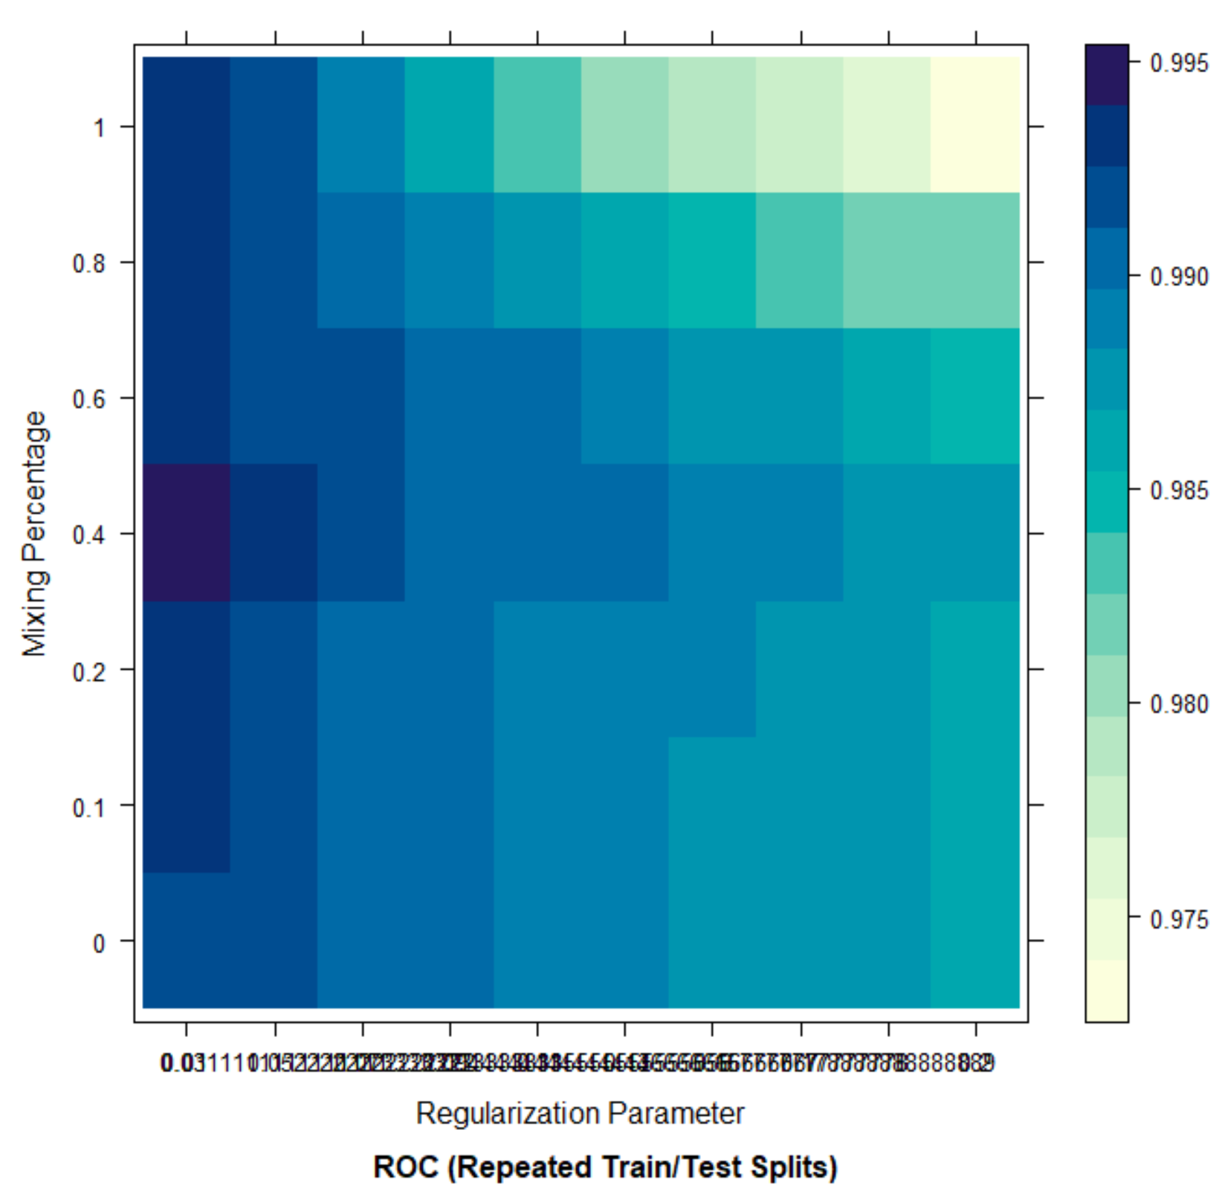
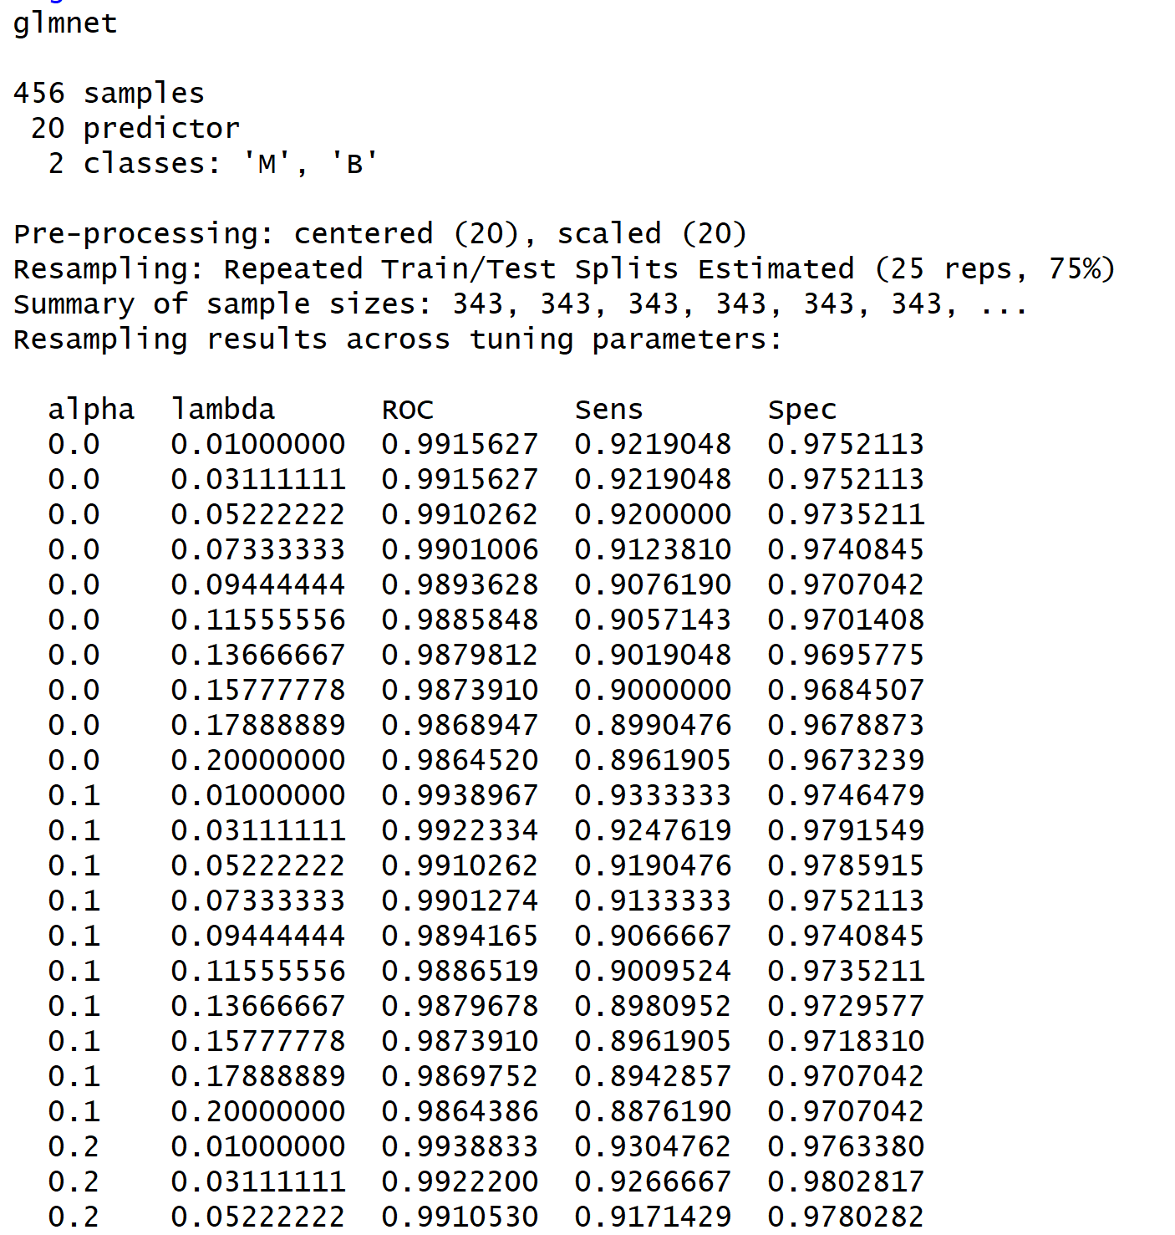
PENALIZED MODEL
Model Plot
Training

Slide 25
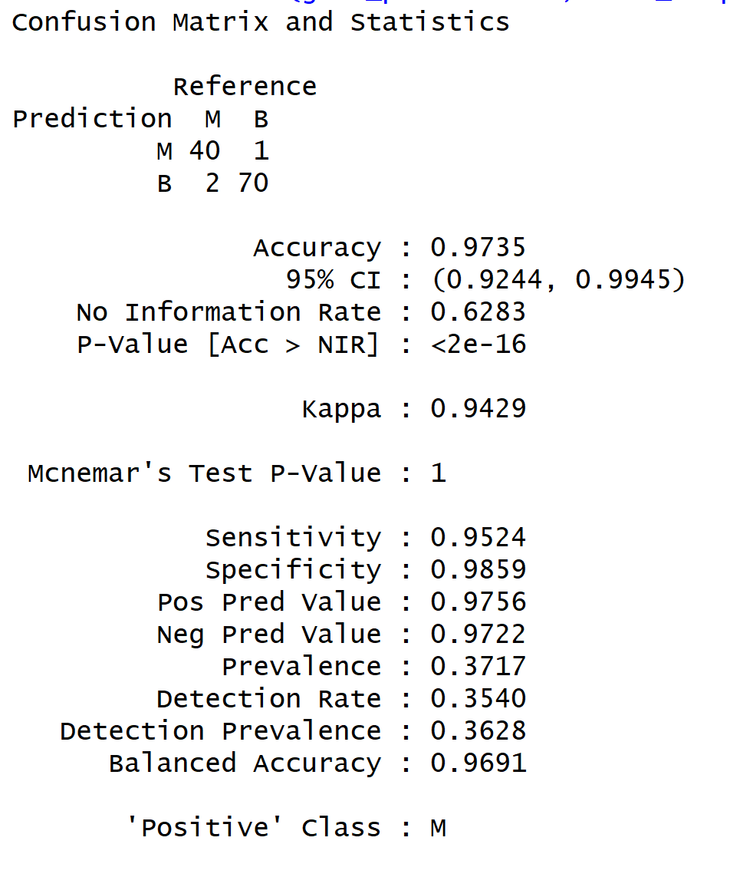
Confusion Matrix

Slide 26
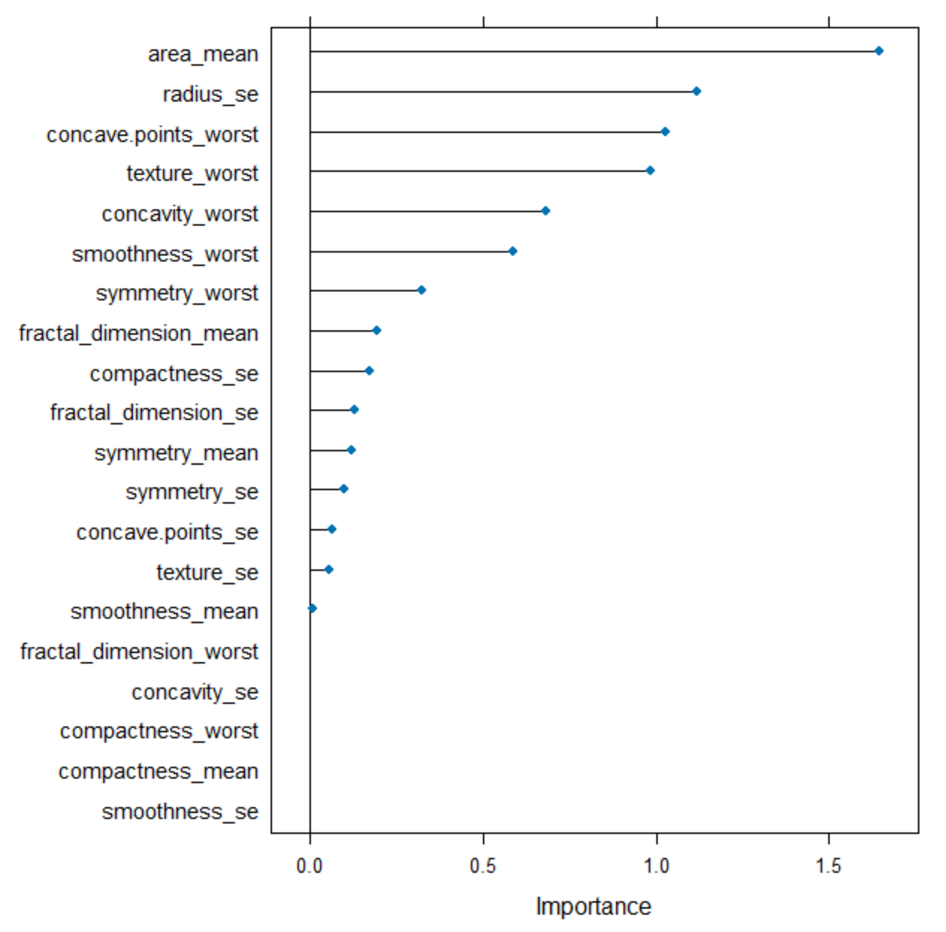
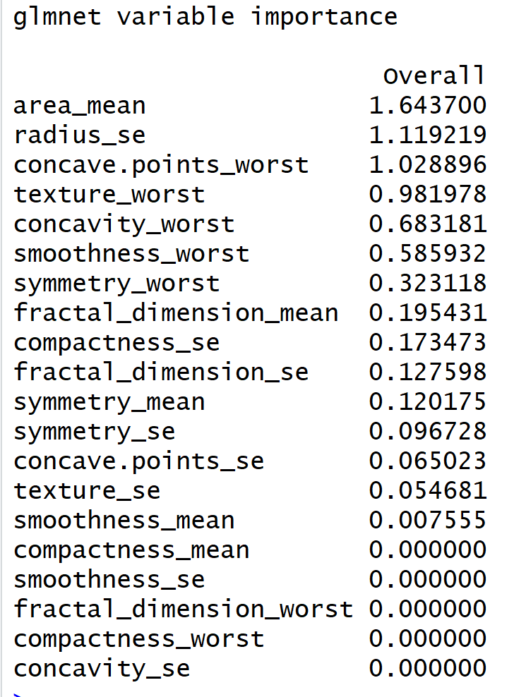
VARIABLE OF IMPORTANCE

Slide 27
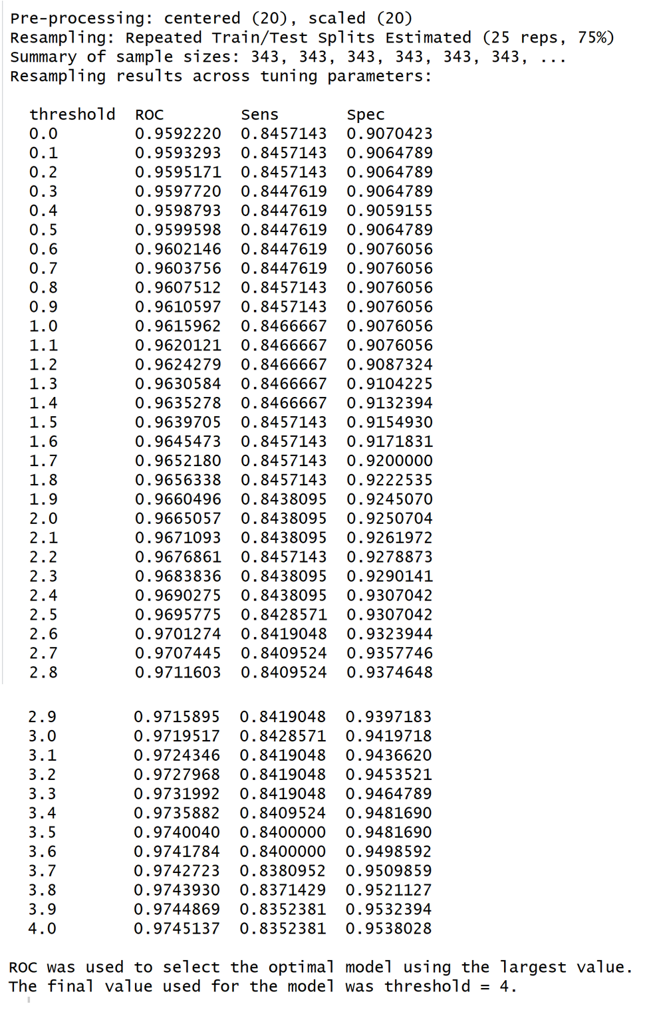
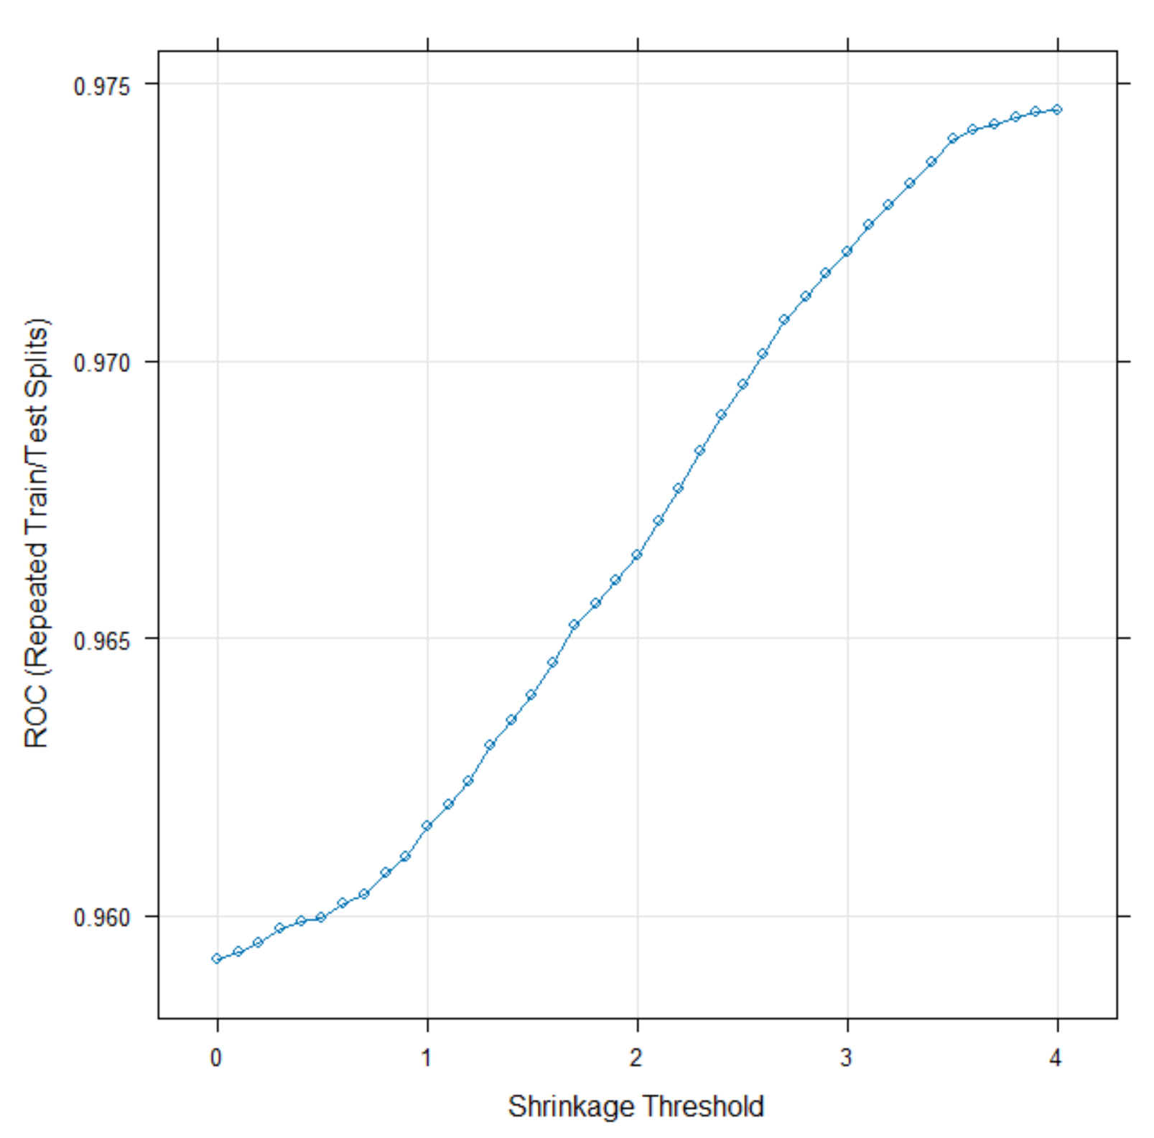
NEAREST SHRUNKEN CENTROIDS
Training
Model Plot

Slide 28
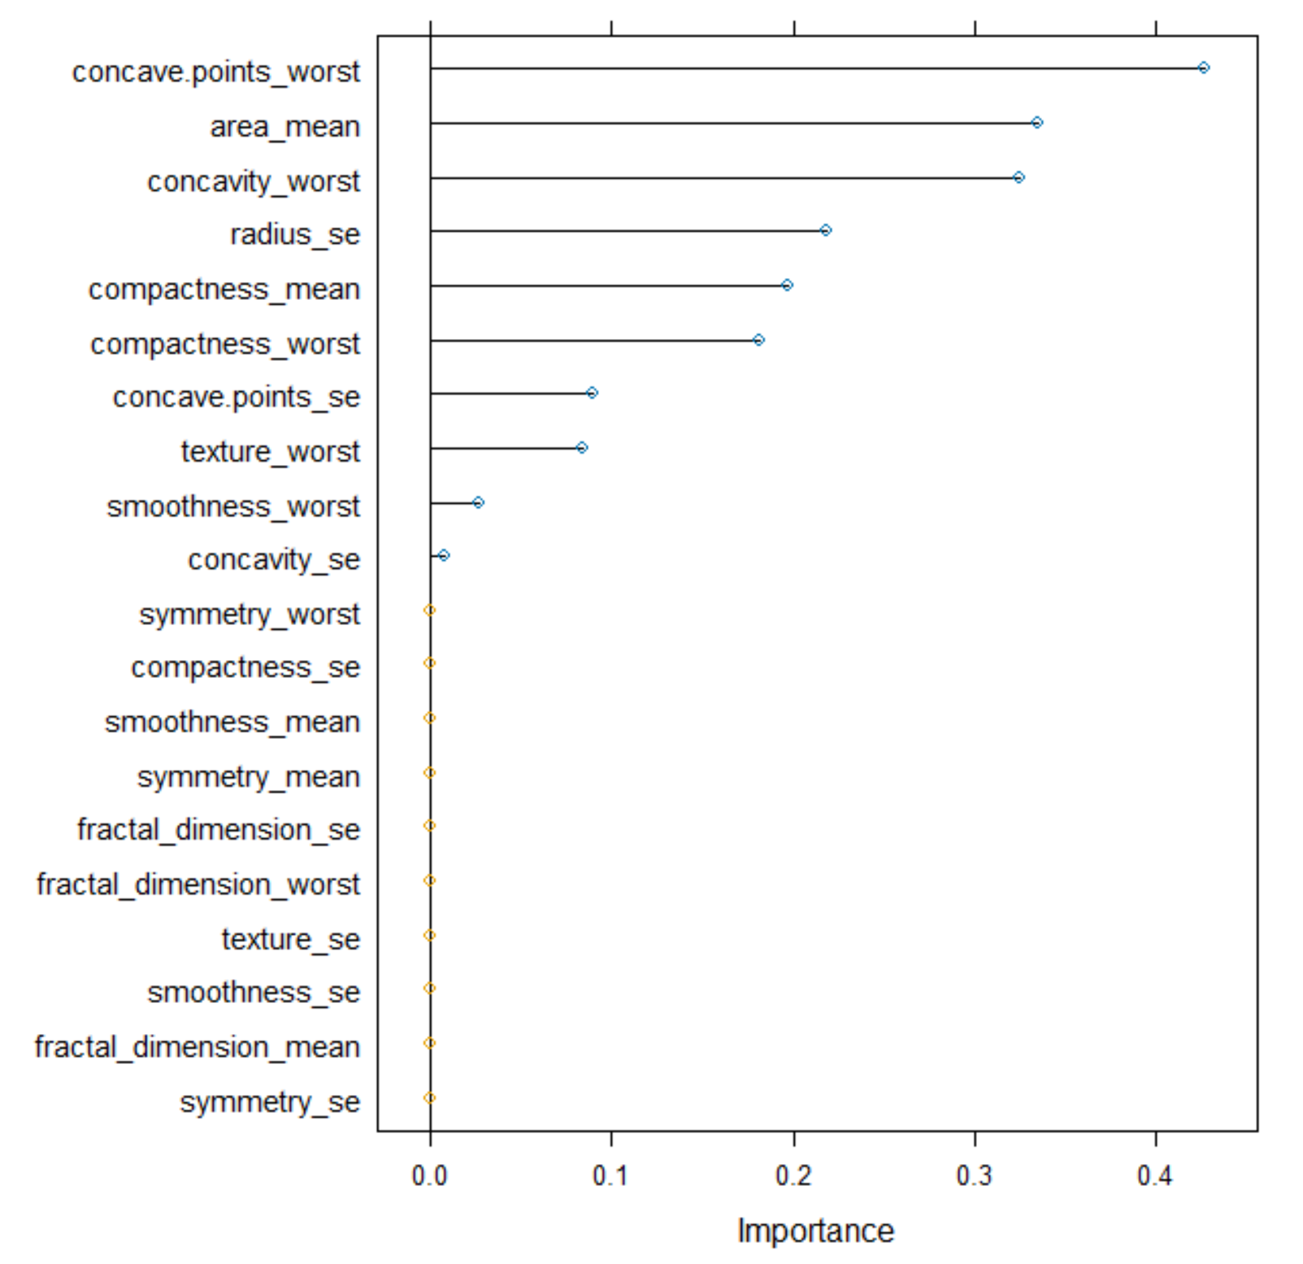
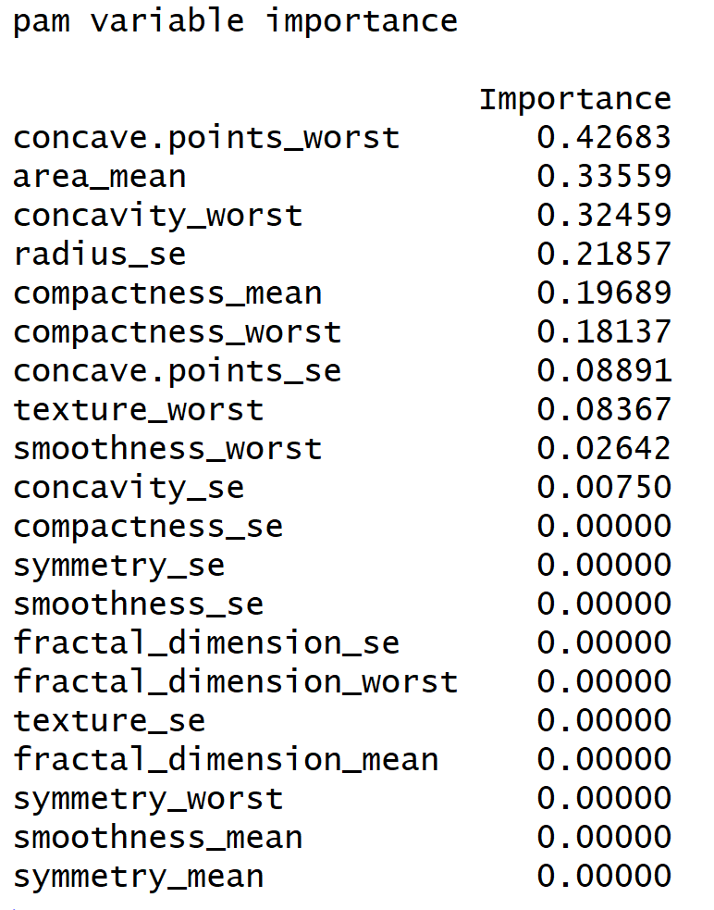
Variable of Importance

Slide 29

Confusion Matrix

Slide 30
NON LINEAR CLASSIFICATION MODELS
NON LINEAR[ MIXTURE DISCRIMINANT ANALYSIS]
REGULARIZED DISCRIMINANT ANALYSIS
NEURAL NETWORK
FLEXIBLE DISCRIMINANT ANALYSIS
SUPPORT VECTOR MACHINE
K NEAREST NEIGHBOR
NAÏVE BAYES

Slide 31
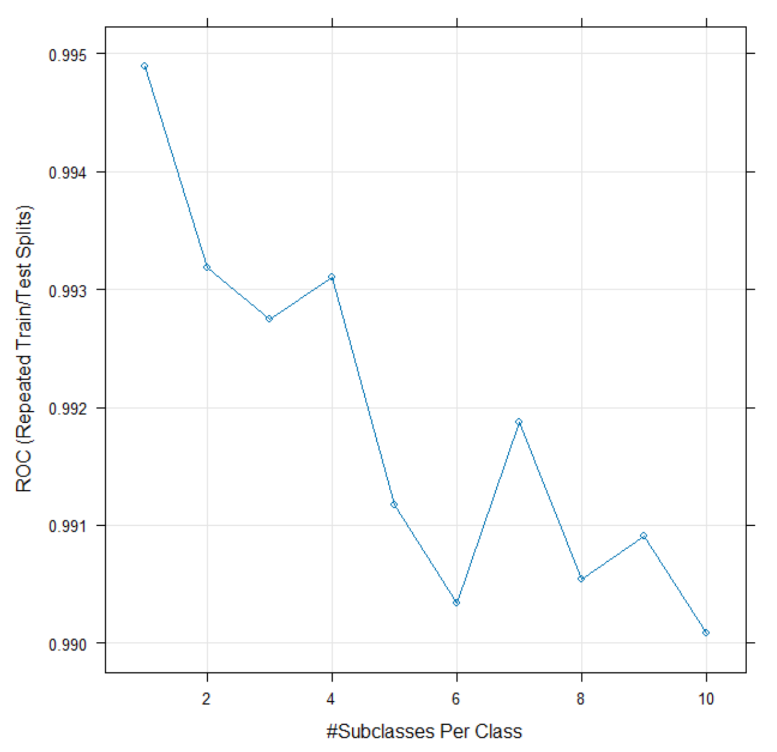
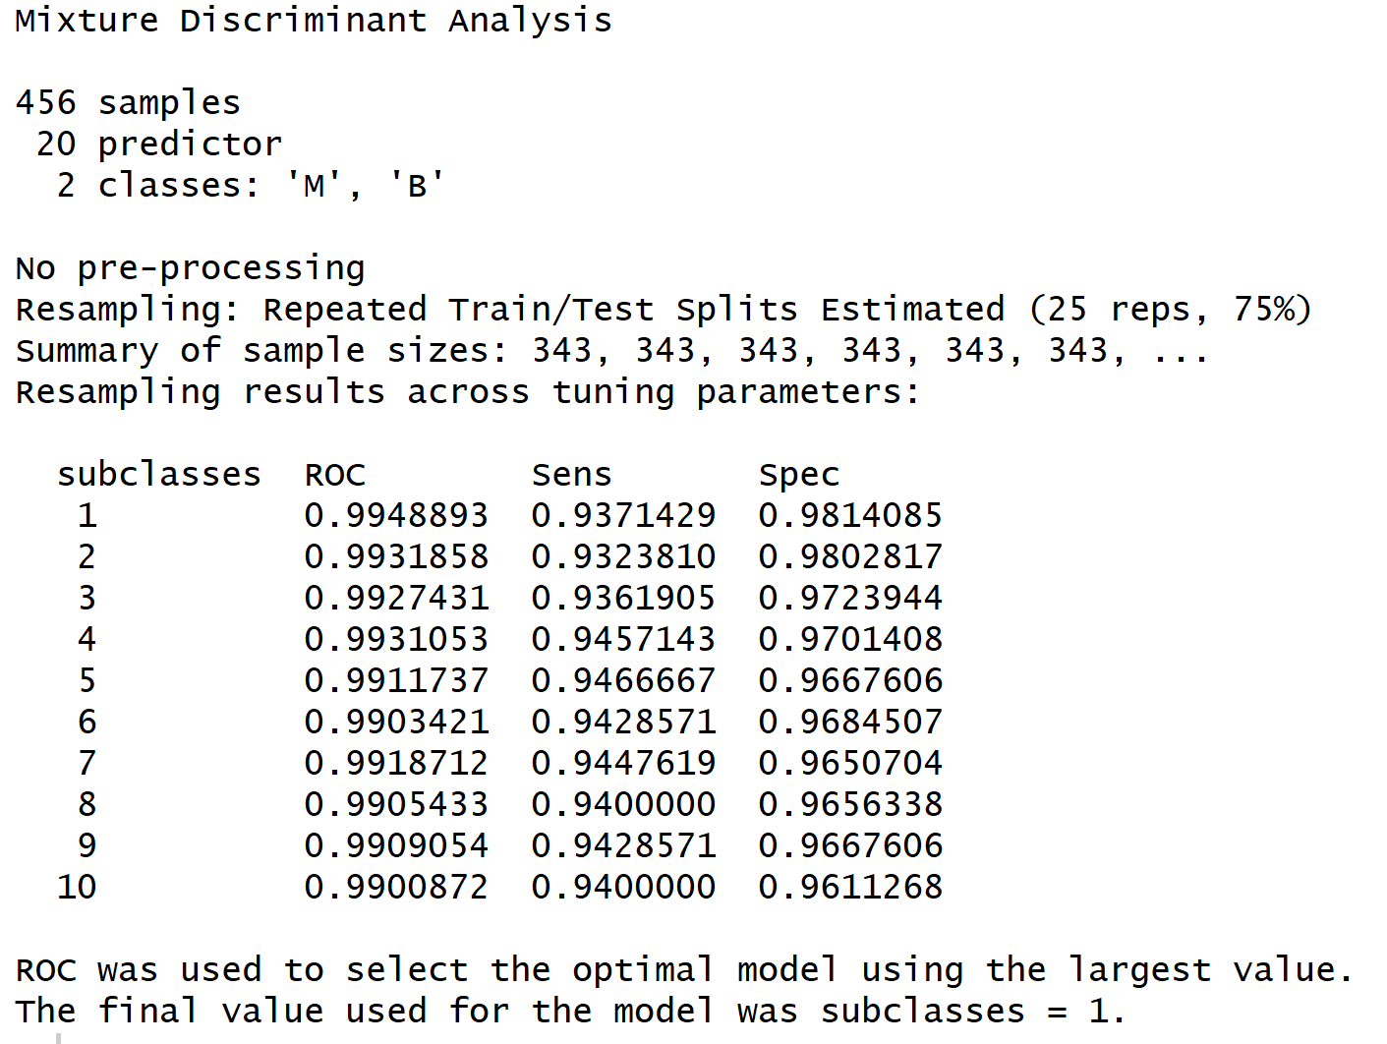
a)MIXTURE DISCRIMINANT ANALYSIS
NON LINEAR DISCRIMINANT ANALYSIS
Model Plot
Training

Slide 32
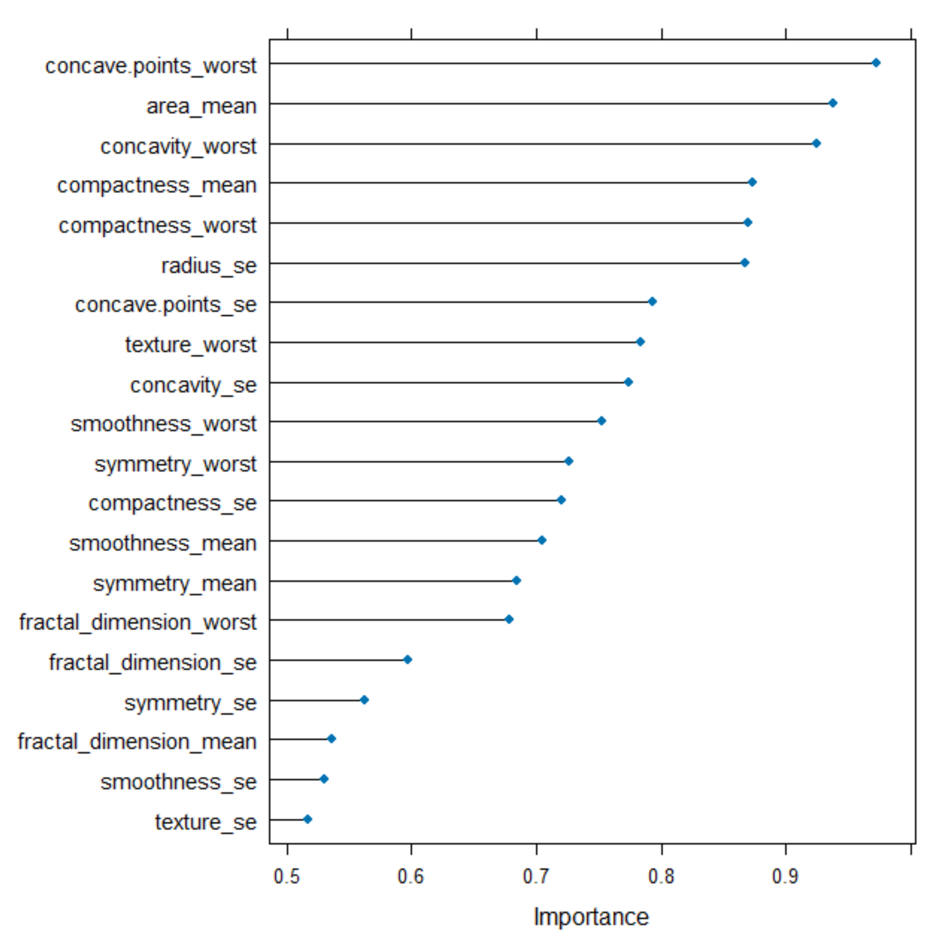
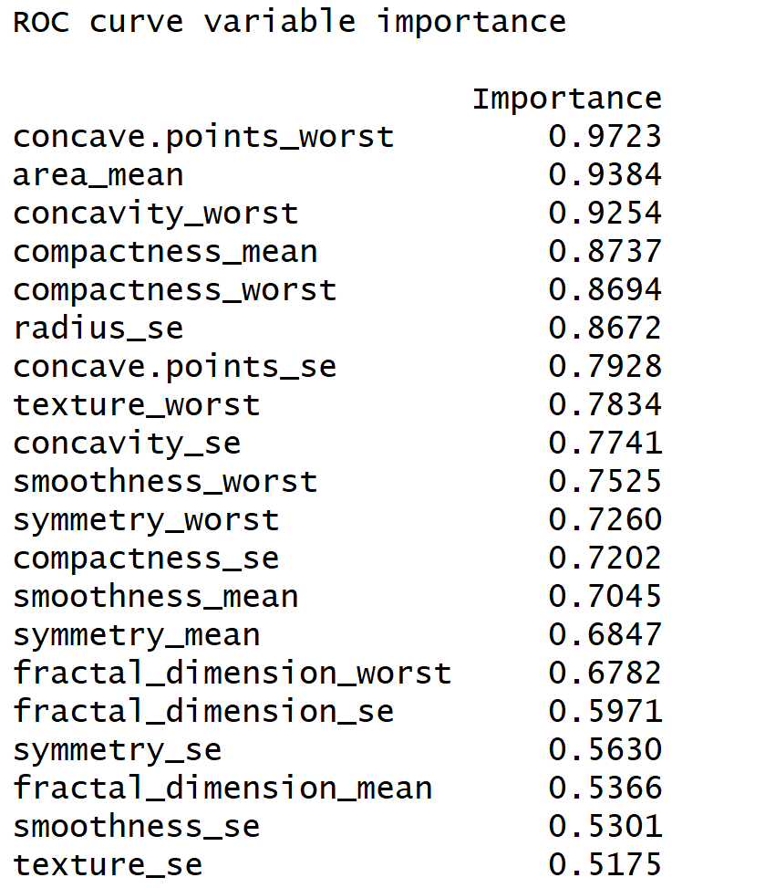
Variable of Importance

Slide 33

Confusion matrix

Slide 34
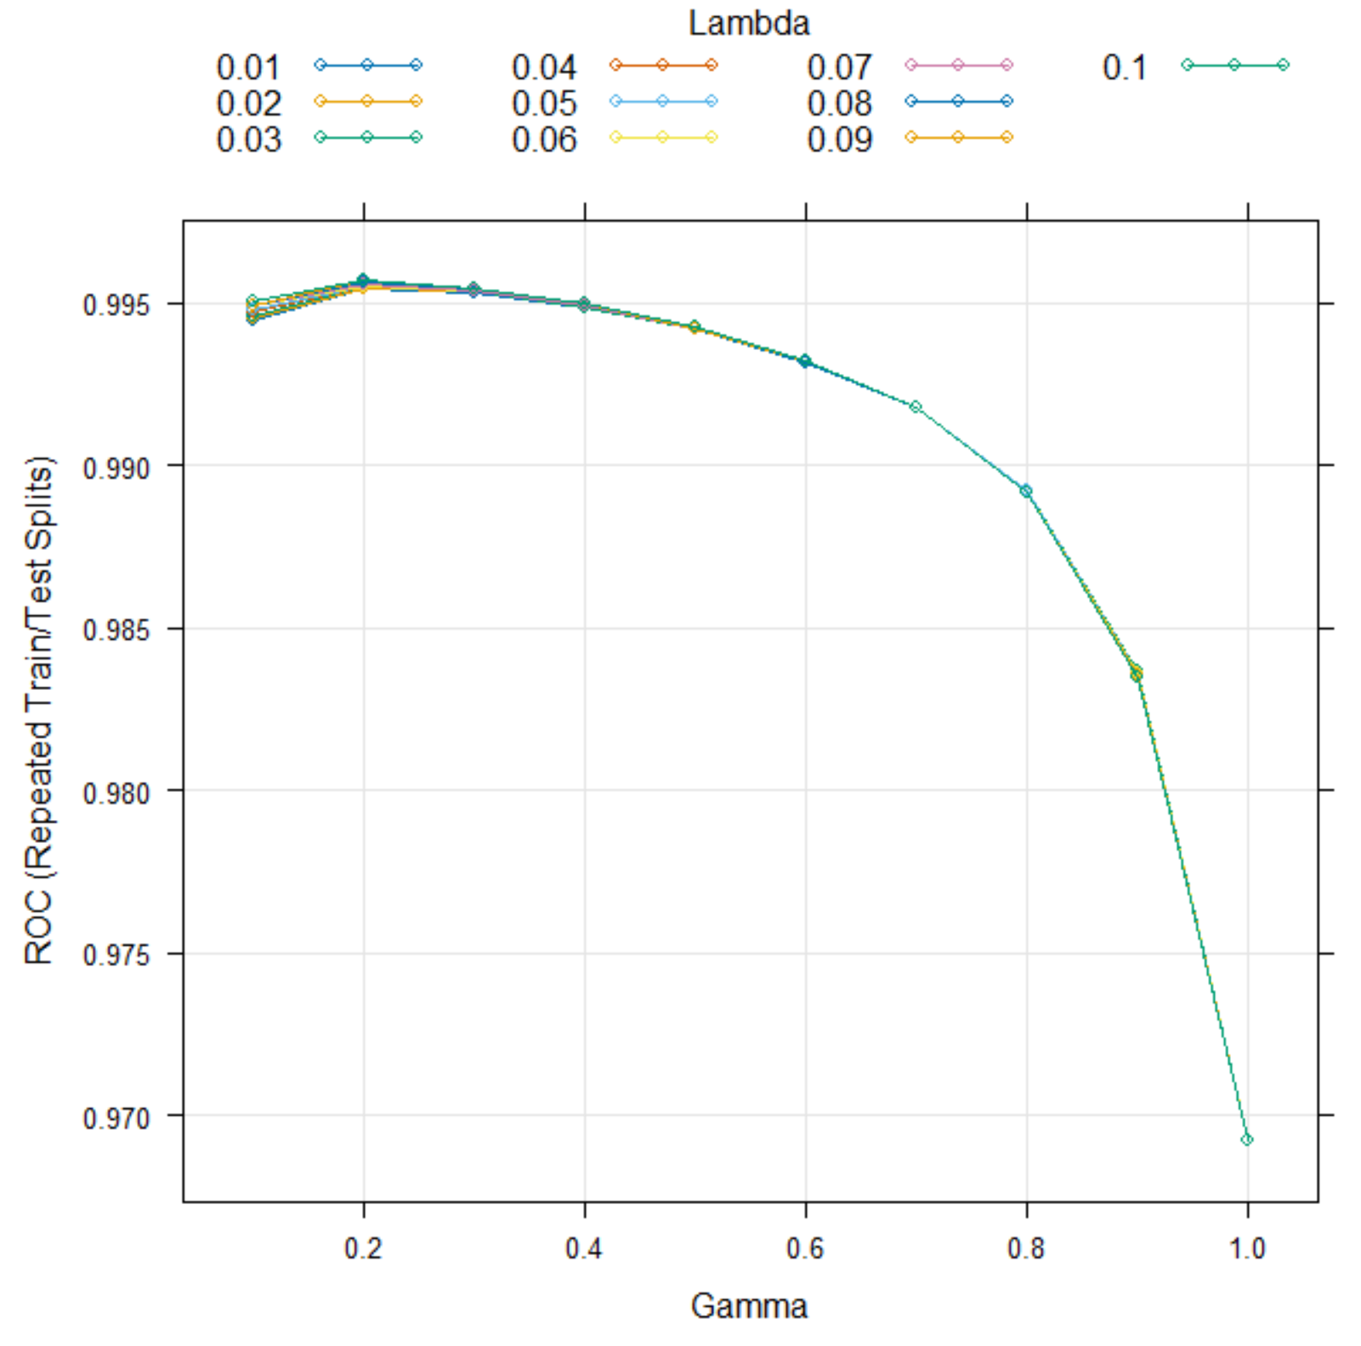
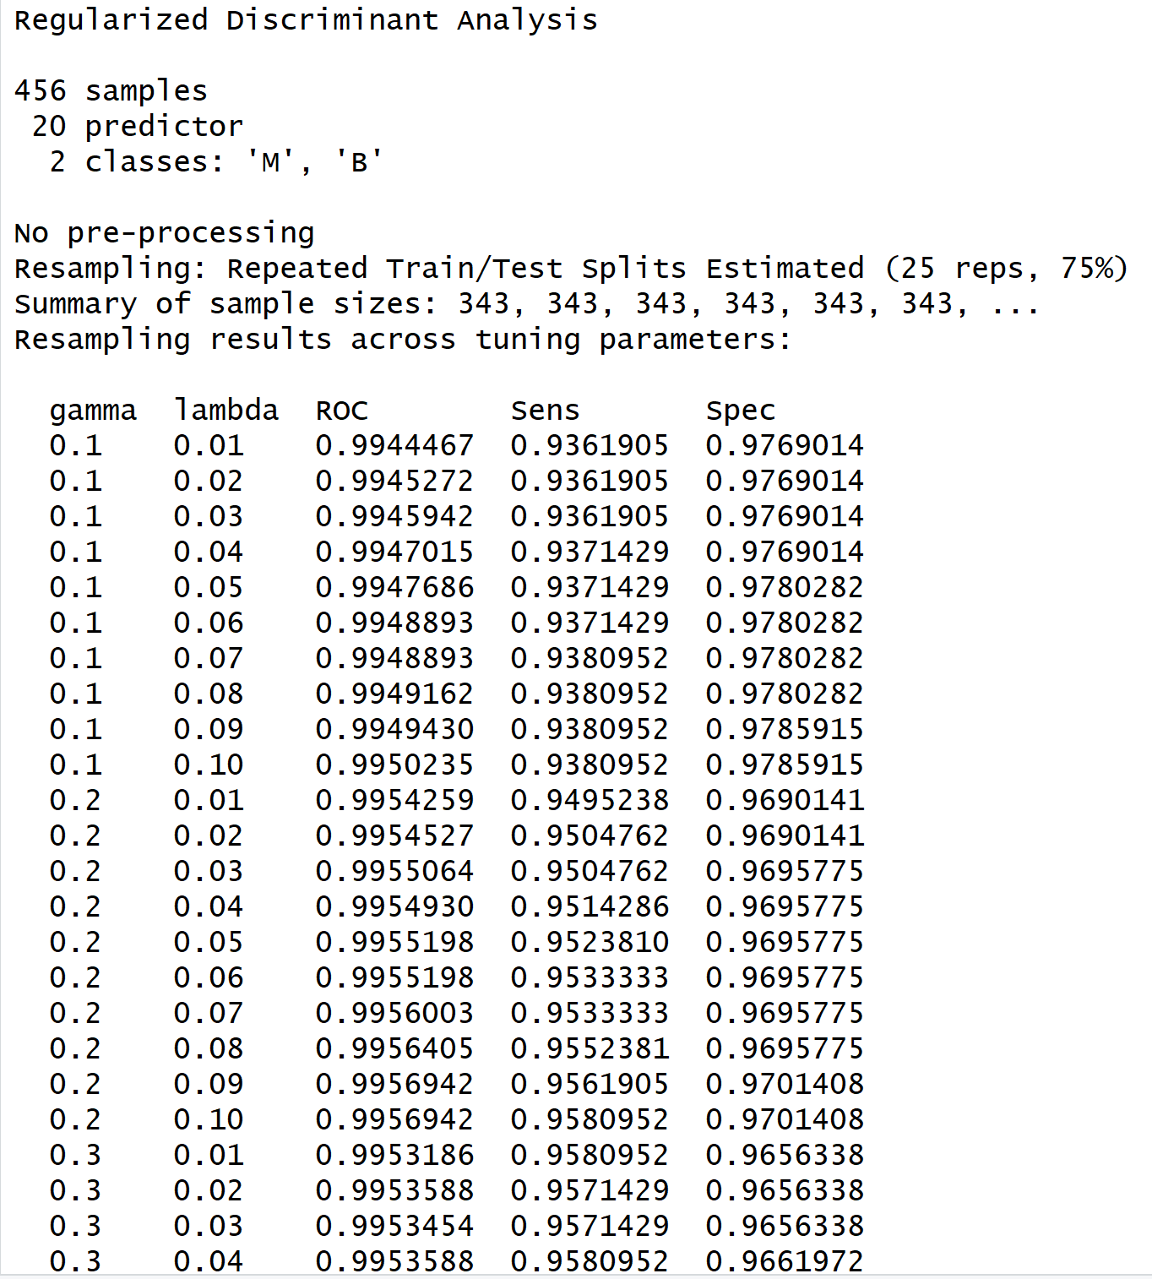
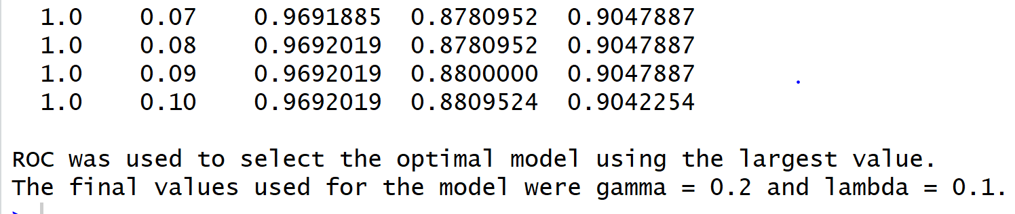
REGULARIZED DISCRIMINANT ANALYSIS

Slide 35
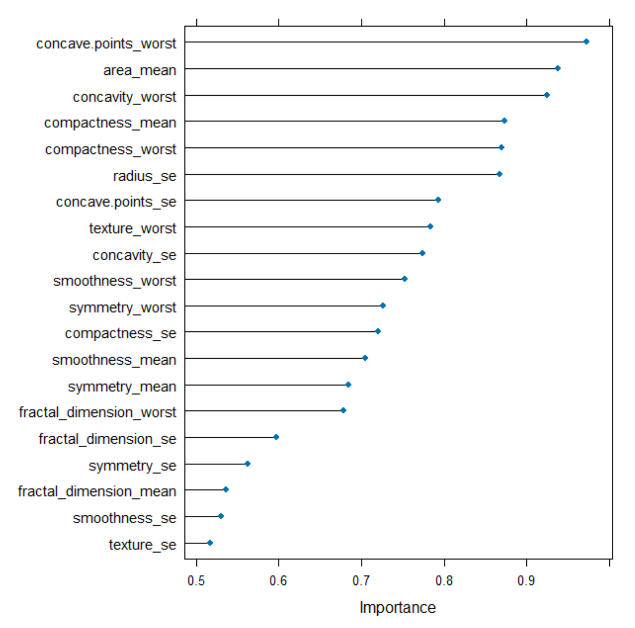
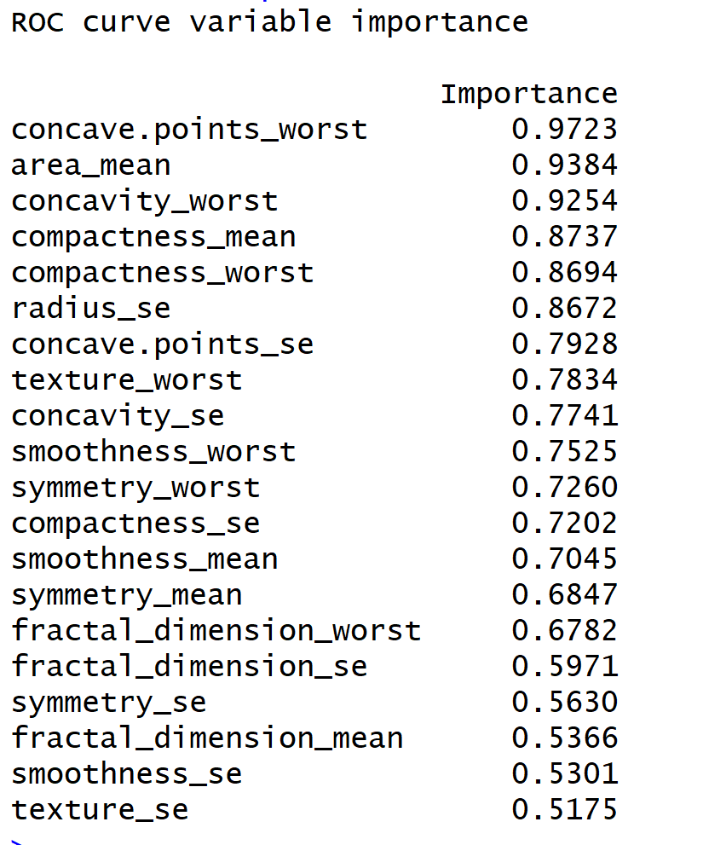
Variable Matrix

Slide 36

Confusion Matrix

Slide 37
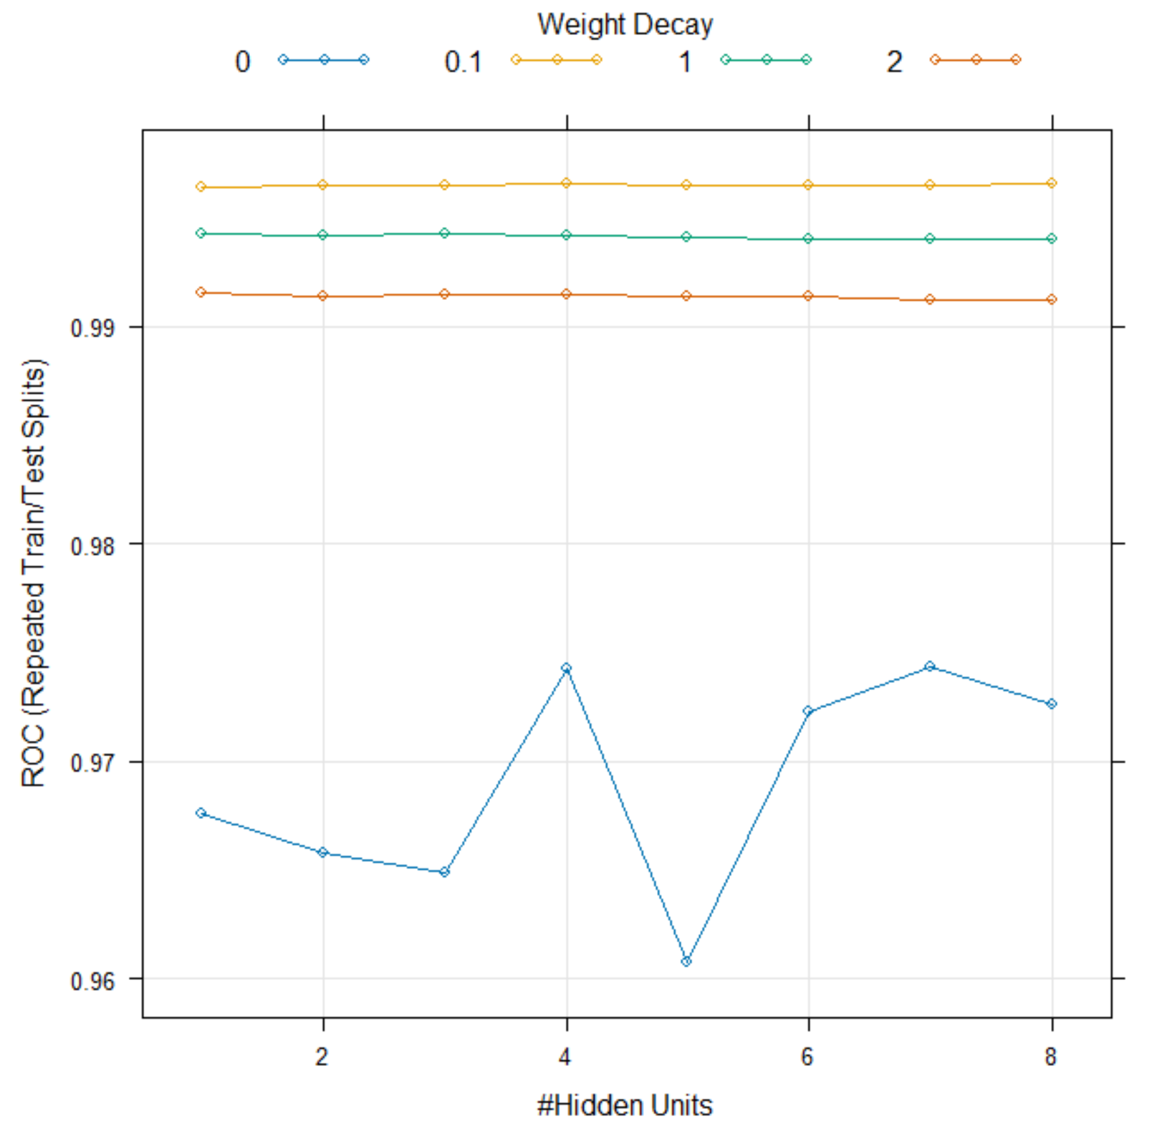
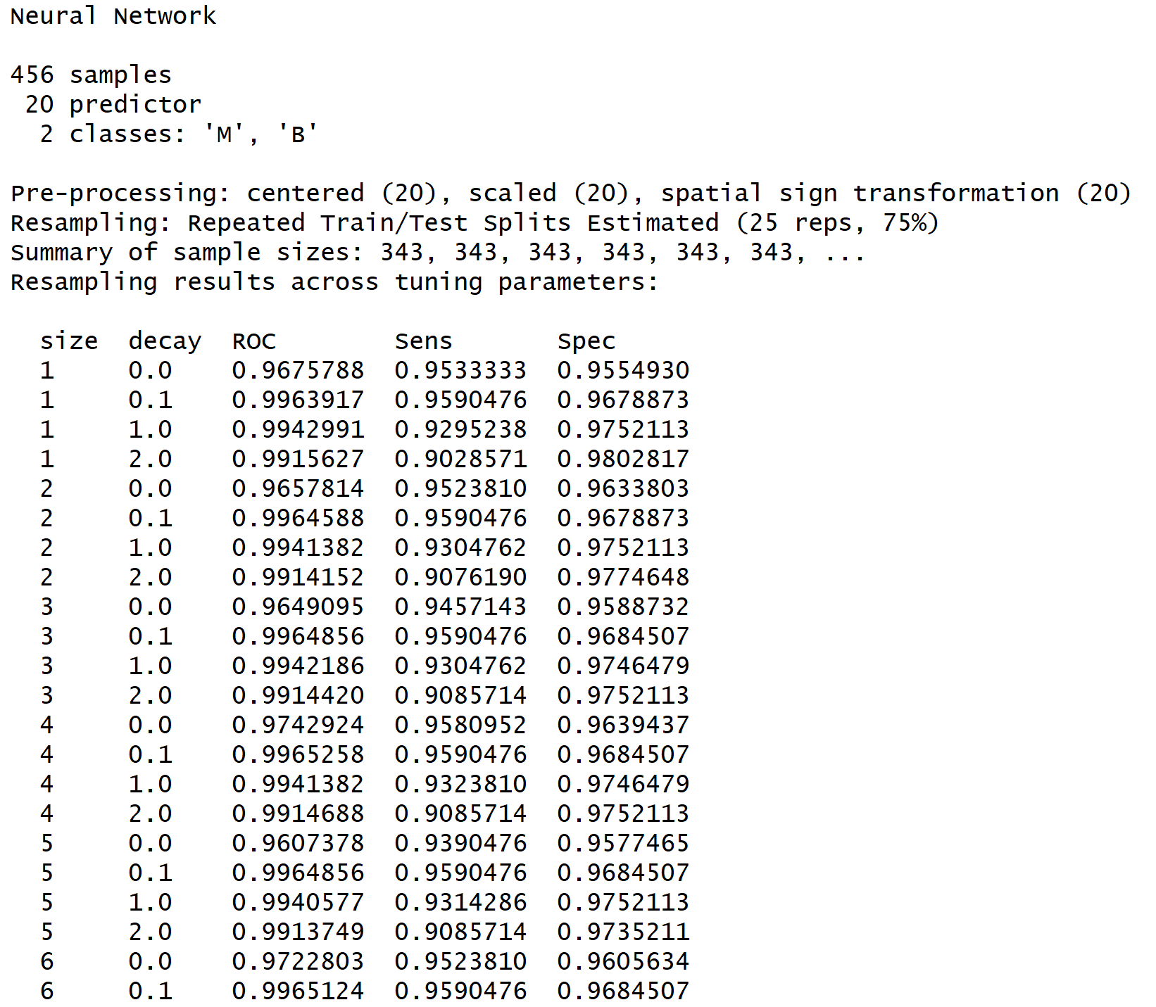
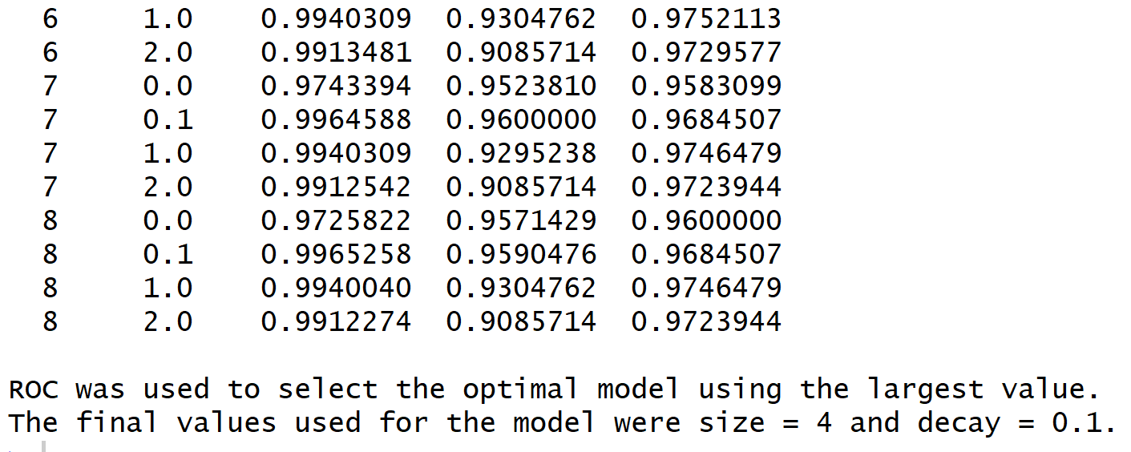
NEURAL NETWORKS

Slide 38
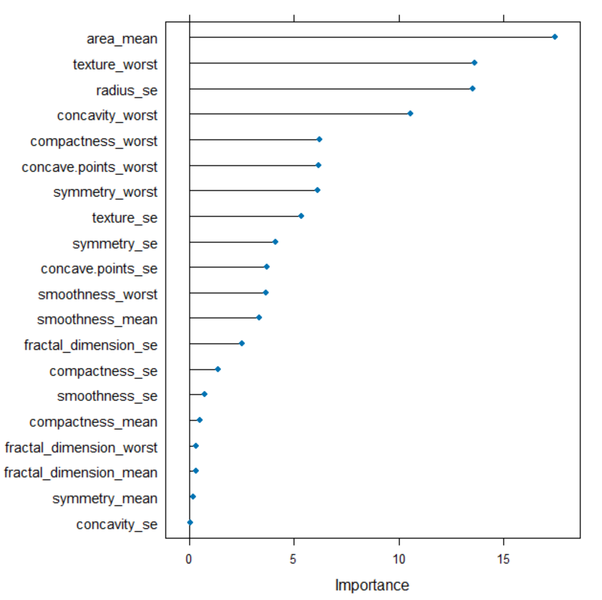
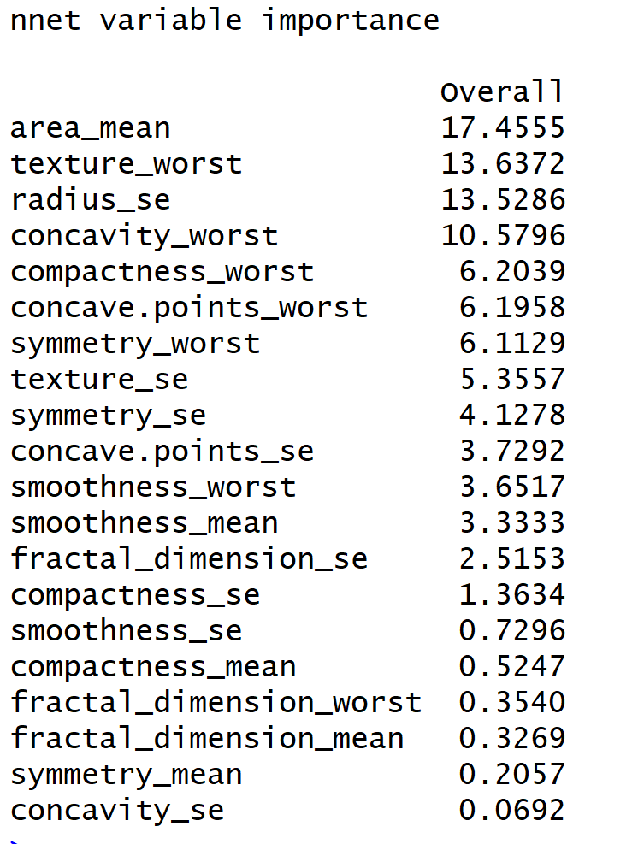
Variable of Importance

Slide 39

Confusion Matrix

Slide 40
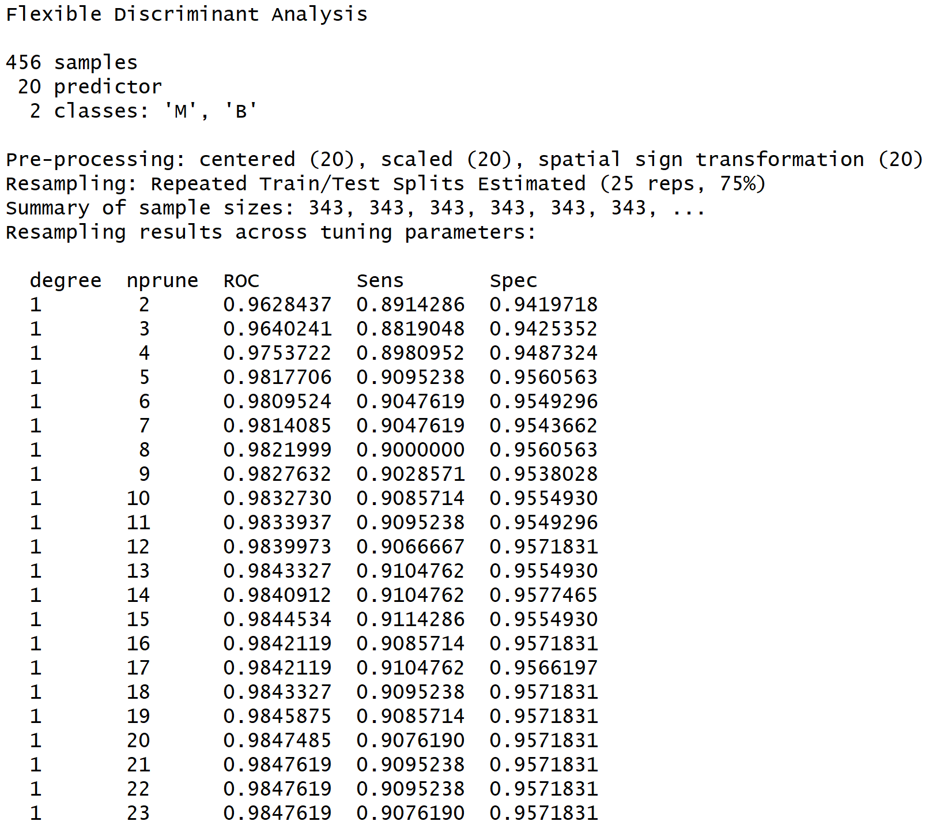
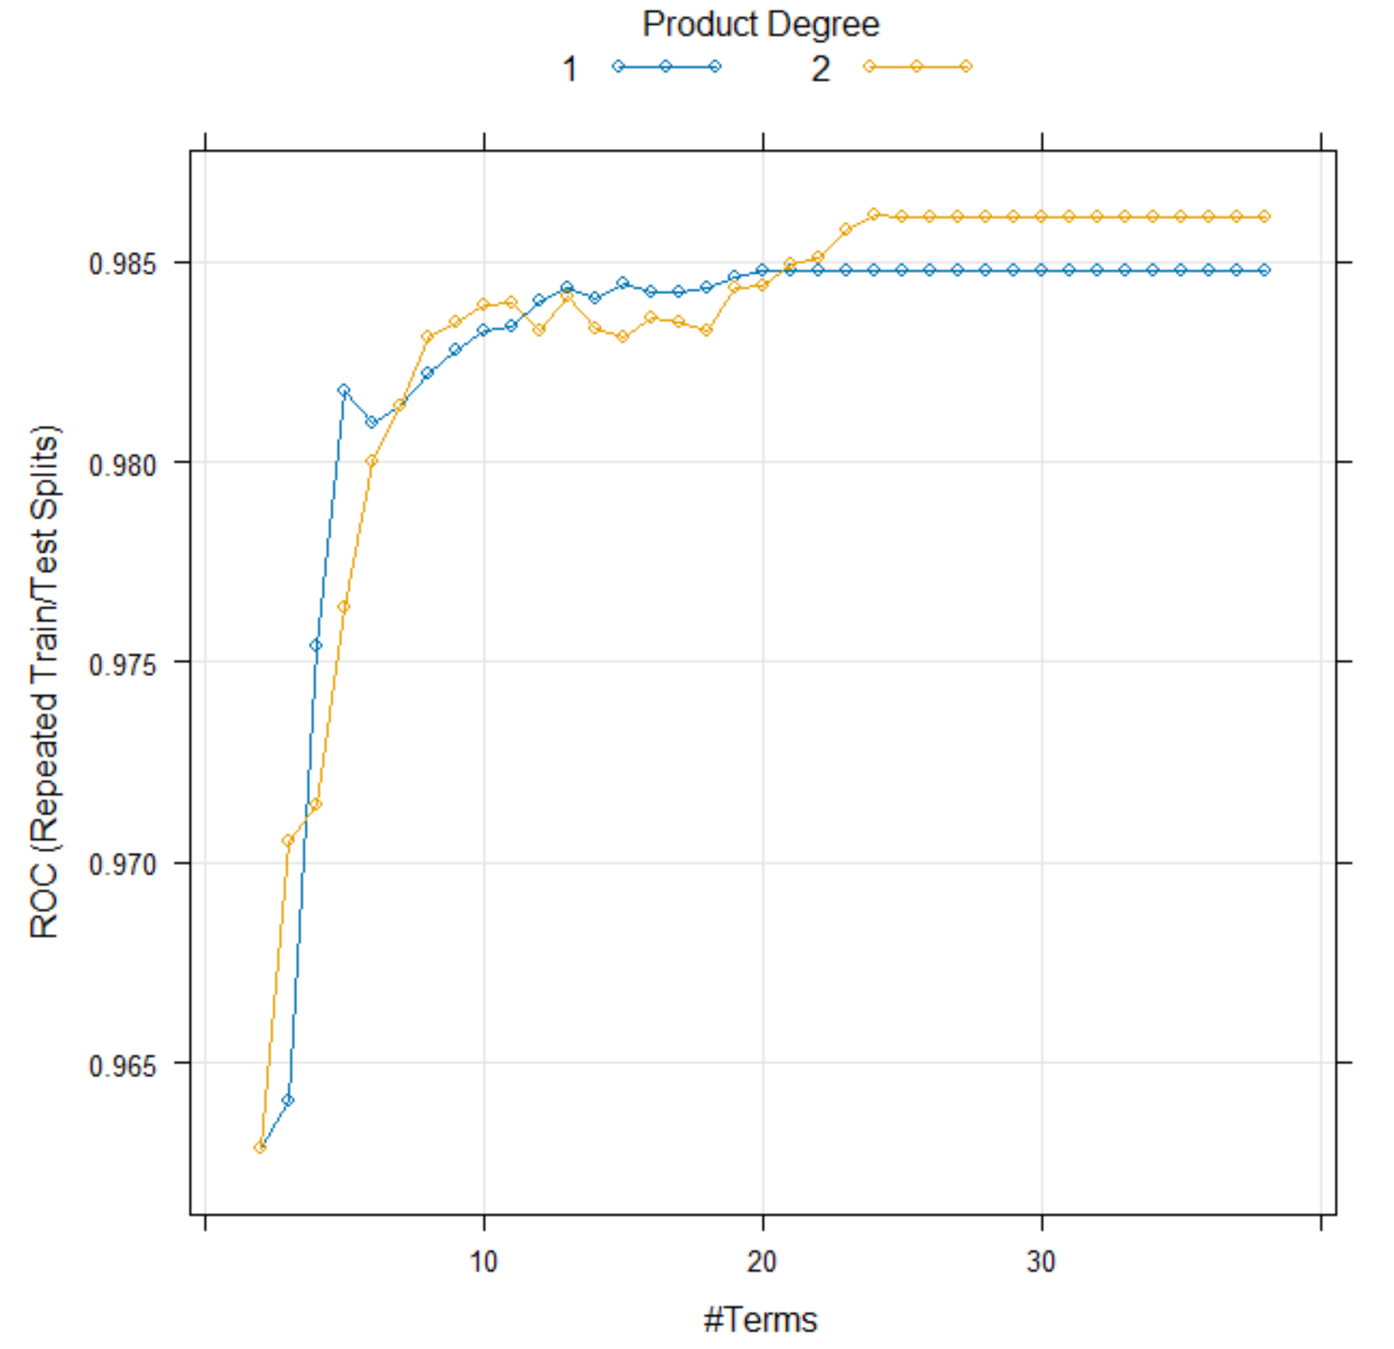
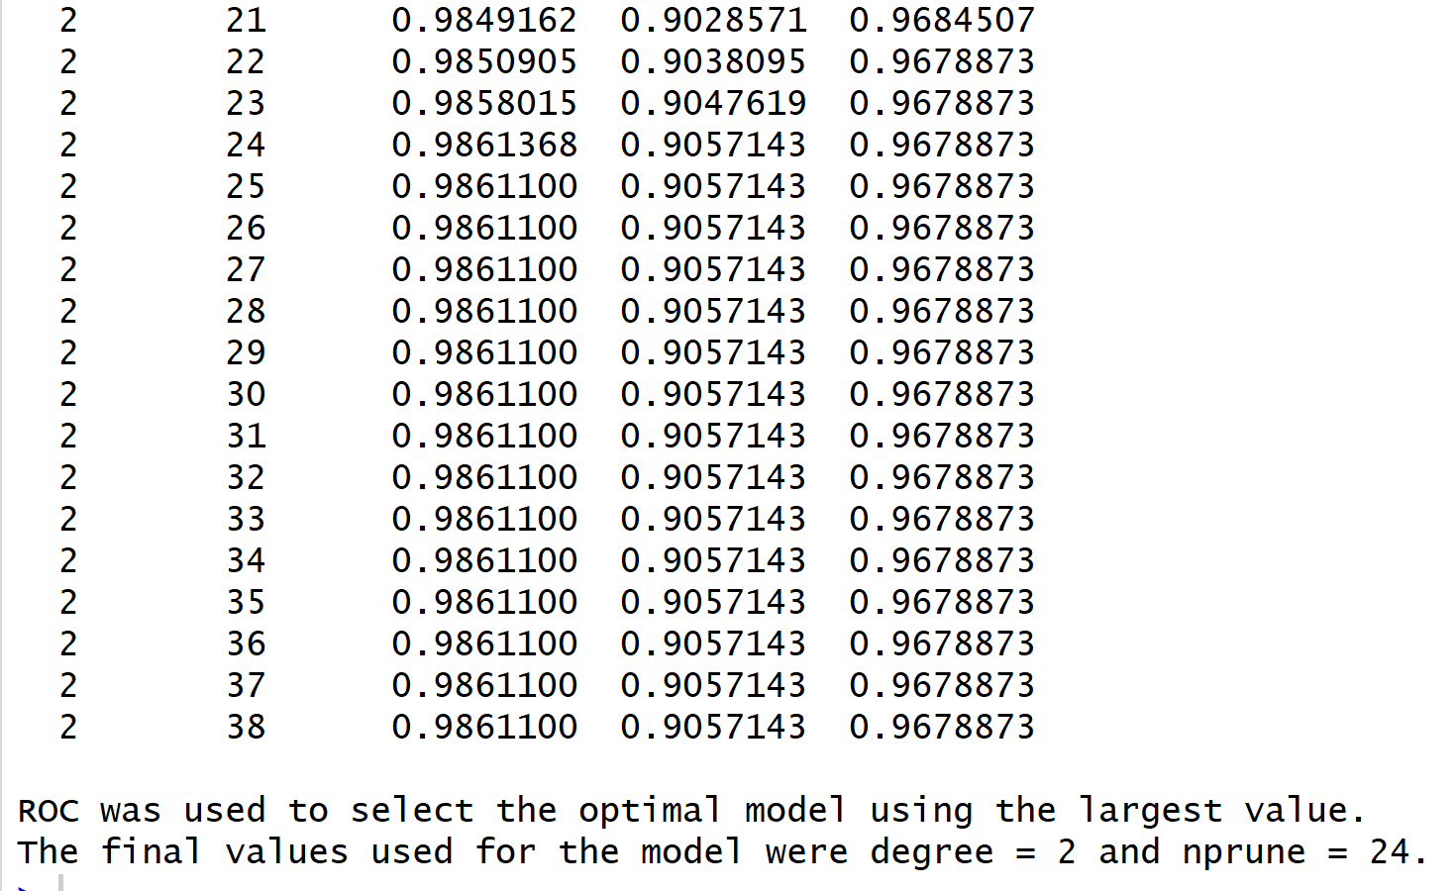
FLEXIBLE DISCRIMIANT ANALYSIS

Slide 41
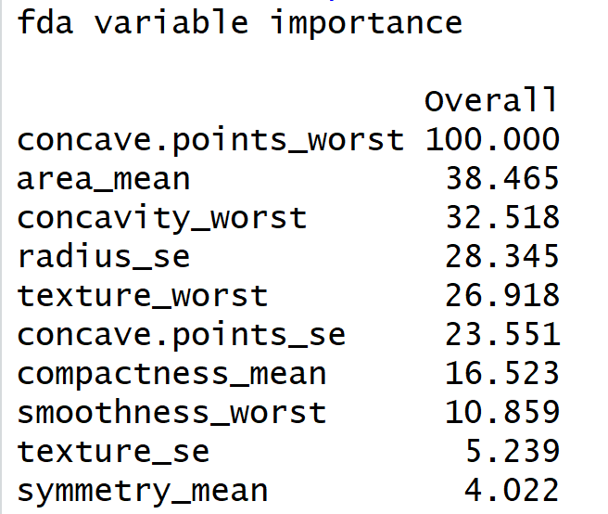


Slide 42

Confusion Matrix

Slide 43


SUPPORT VECTOR MACHINE

Slide 44


Variable of Importance

Slide 45

Confusion Matrix

Slide 46


K NEAREST NEIGHBOR

Slide 47


Variable of Importance

Slide 48

Confusion Matrix

Slide 49

NAÏVE BAYES

Slide 50


Variable of Importance

Slide 51

Confusion Matrix

Slide 52


BEST LINEAR MODEL
The Penalized Model is the best because it consistently shows high performance across all the metrics. It suggests that the model balances the trade-off between sensitivity and specificity well while maintaining high overall accuracy and a strong agreement between predictions and actual outcomes. This balance is crucial for a robust model, especially in practice where both false positives and false negatives carry a cost.

Slide 53

Top variables for the best Linear model, Penalized Model

Slide 54

BEST NON LINEAR MODEL
The Neural Network model and Support Vector Machine model had the best Accuracy and Kappa values compared to all the models.

Slide 55

Top variables for the best Non-Linear model, Neural Network

Slide 56

Top variables for the best Non-Linear model, SVM

Slide 57

OVERALL BEST MODEL
Considering the best overall model between the best Linear and Non Linear model, The Penalized model has higher testing accuracy and testing Kappa values as compared to Neural Network model. Hence the best overall model is the Linear Penalized model.

Slide 58
The best overall variables are from the Penalized model

